Slide 1

Have you heard this music?
Have you seen the film? The musical?
Do you know the author?

Slide 2
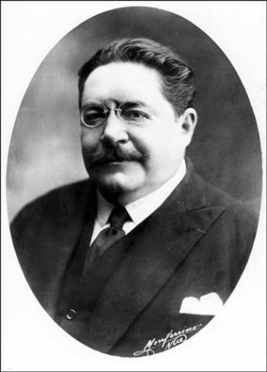
Gaston Leroux
Born: 6 May 1868 Paris, France
Died: 15 April 1927 (aged 58) Nice, France
Occupation: Journalist, Author
Nationality: French
Notable works: The Phantom of the Opera

Slide 3

When was G. Leroux born?
What did he study at the university?
Where did he work?
What is he best known for?
When was «The Phantom of the Opera» written?
What’s the story about?
Have you seen the film?
Have you heard about the musical by A. L. Webber?

Slide 4
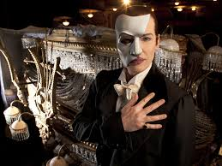
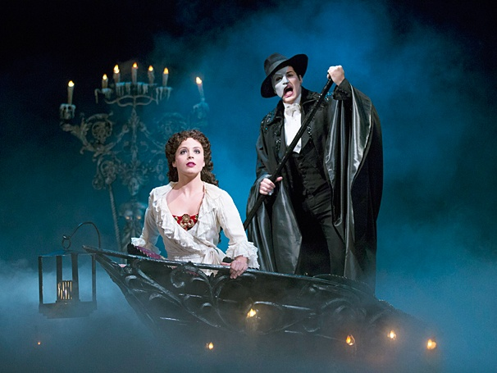
In 1988 A. L. Webber composed his new musical
« The Phantom of the Opera».
It is also the longest running Broadway musical of all time and the most financially
successful Broadway show in history.
«The Phantom of the Opera» was translated into several languages and was produced in more than twenty countries.

Slide 5
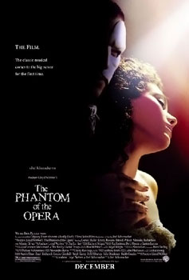
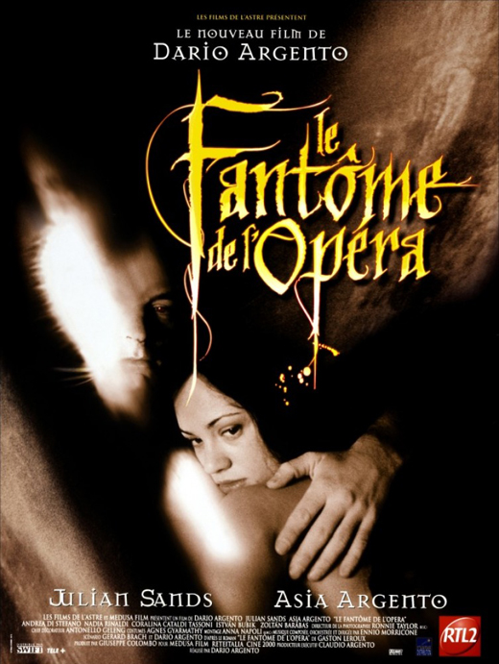
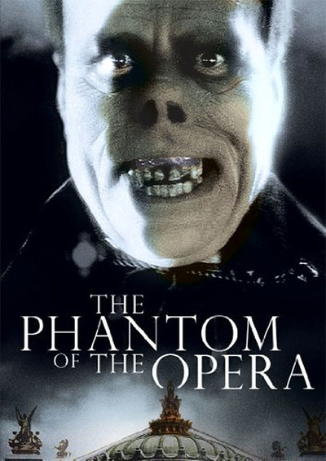
The novel has been made into several films. In 2004 a British film adaptation was released. It was produced and co-written by Lloyd Webber. The Phantom of the Opera grossed approximately $154 million worldwide, despite receiving mixed to negative reviews.
The Phantom of
the Opera (1925)
Phantom of the Opera 1998 poster
Phantom of the Opera
2014 poster

Slide 6
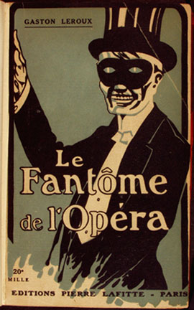
Relaxed –
at ease
Arguing –
quarreling
Disappeared –
vanished
Trick –
practical joke
Run away –
fled
Clearly –
plainly
Walked in a stiff,
angry way -
stalked

Slide 7
The point of life where one has given up full-time work –
retirement
Entered a place at once in a way that was difficult to cope with –
invaded
Ran quickly
rushed
Just about to retire or leave a job
resigning
Pointing upwards
upturned
Shaking –
trembling
A picture or design that has been cut into a surface –
ingraving
Very troublesome children –
brats
Believing in something whose existence cannot be proved by science –
superstitious

Slide 8
Made small involuntary movements due to fear or cold –
shook
The skin on a person’s face –
complexion
Silly talk or waste –
rubbish
Was courageous enough to try or do smth
dared
A ghost-like figure –
spectre
Person who organizes funerals and buries people –
undertaker
A story about mythical or supernatural beings or events –
legend
Strange –
peculiar
Extremely well –
extraordinarily
The dark part of the eyes –
pupils
Bunches of hair that grow together -
locks

Slide 9
 | Description in the text | In the picture
face
dressing
body

Slide 10
Выполнила:
Актимирова Вероника Руслановна студентка ПККиК 3 курс «театральное творчество»
Преподаватель: Глухова Ирина Викторовна

