Slide 1
Good morning!

Slide 2
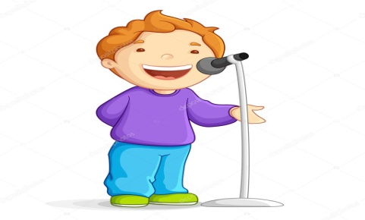
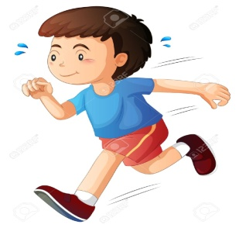
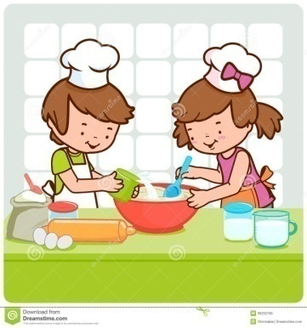
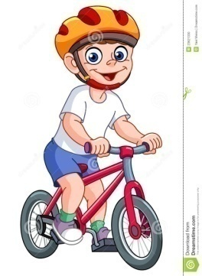
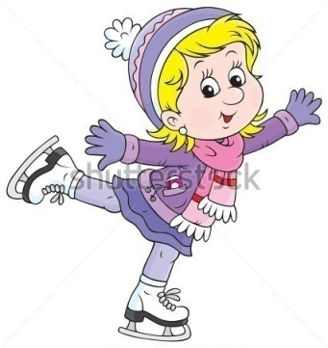
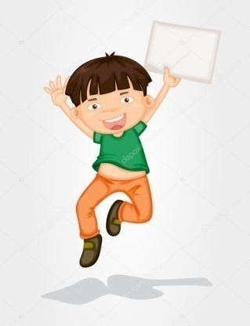
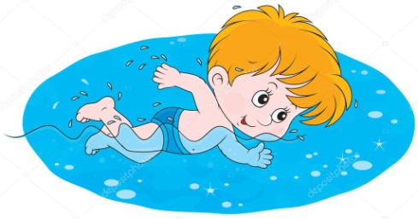
1
5
1
2
2
6
3
4
3
5
7
6
7
4
8
8

Slide 3
1
5
s
i
n
g
2
2
6
3
4
3
5
7
6
7
4
8
8

Slide 4
1
5
s
i
n
g
2
r
u
n
6
3
4
3
5
7
6
7
4
8
8

Slide 5
1
5
s
i
n
g
2
r
u
n
6
b
i
k
e
4
3
5
7
6
7
4
8
8

Slide 6
1
5
ss
i
n
g
2
r
u
n
6
b
i
k
e
j
u
m
p
3
5
7
6
7
4
8
8

Slide 7
5
s s
i
n
g
r
u
n
6
b
i
k
e
j
u
m
p
3
r
e
a
d
7
6
7
4
8
8

Slide 8
1
5
S
ss
i
n
g
2
r
u
n
6
b
i
k
e
j
u
m
p
3
r
e
a
d
7
c
o
o
k
7
4
8
8

Slide 9
1
5
ss
i
n
g
2
r
u
n
6
b
i
k
e
j
u
m
p
3
r
e
a
d
7
c
o
o
k
s
k
a
t
e
4
8
8

Slide 10
1
5
ss
i
n
g
2
r
u
n
6
b
i
k
e
j
u
m
p
3
r
e
a
d
7
c
o
o
k
s
k
a
t
e
4
s
w
i
m
8

Slide 11
Тема урока

Slide 12
Тема урока
School subjects

Slide 13
Цель урока

Slide 14
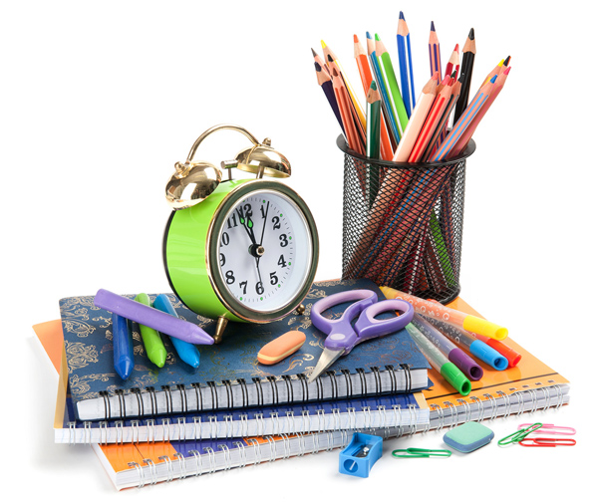
Цель урока :
Повторить названия учебных предметов.

Slide 15
At the lesson today

Slide 16
What is the lesson?

Slide 17
It’s Music.

Slide 18
What is the lesson?

Slide 19
It’s reading.

Slide 20
What is the lesson?

Slide 21
It’s sport.

Slide 22
What is the lesson?

Slide 23
It’s Russian.

Slide 24
What is the lesson?

Slide 25
It’s English.

Slide 27
At this lesson we…
Subjects | Description
1. Music | a) At this lesson we learn our planet and animals.
2. Natural history | b) At this lesson we sing songs.
3. Sport | c) At this lesson we learn English language.
4. Art | d) At this lesson we can run and jump.
5. English | e) At this lesson we draw.

Slide 28
Check your answers.
Subjects | Description
1. Music | e) At this lesson we sing songs.
2. Natural history | d) At this lesson we learn about our planet and animals.
3. Sport | a)At this lesson we can run and jump.
4. Art | b) At this lesson we draw.
5. English | c) At this lesson we learn English language.

Slide 29
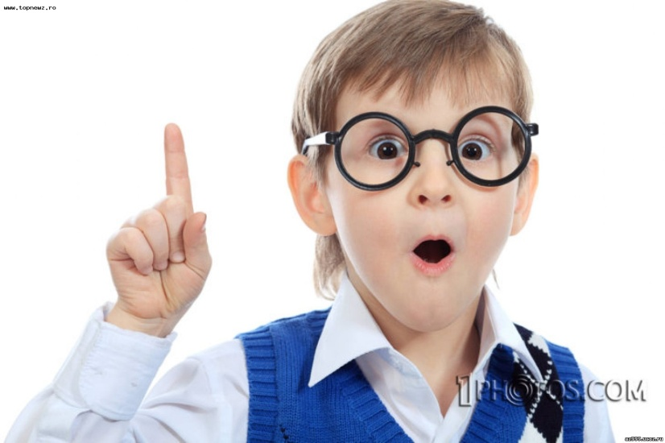
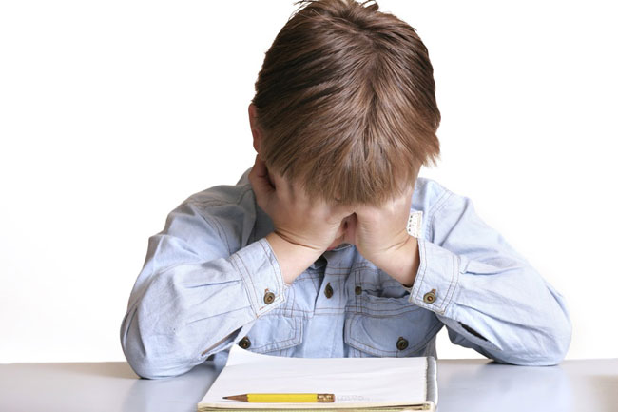
What subjects are you good or bad at?
I’m good at…….
I’m bad at……

Slide 30
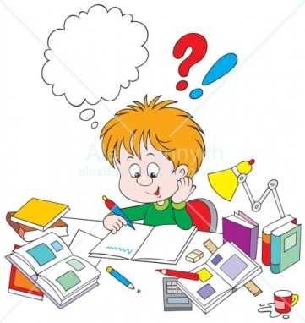
Ann’s timetable.
Monday
Wednesday
1. English
2. Maths
3. German
4. History
5. IT
1. Geography
2. English
3. Sport
4. History
5. Russian

Slide 31
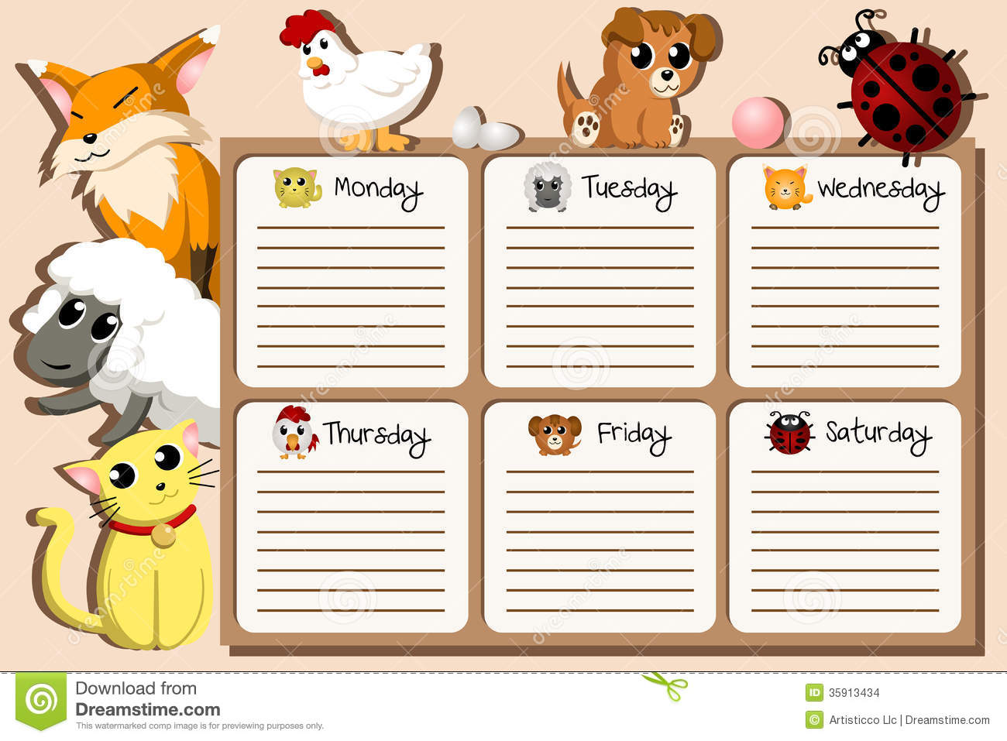

Slide 33
Write down your homework
Упражнение 1 страница 19, правило страница 19-20 (учить числительные )

Slide 34
What are you feel?
I feel happiness!
I feel sad!

Slide 35
The lesson is over!

