Slide 1
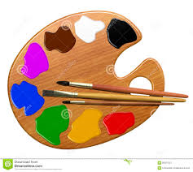
COLOUR

Slide 2
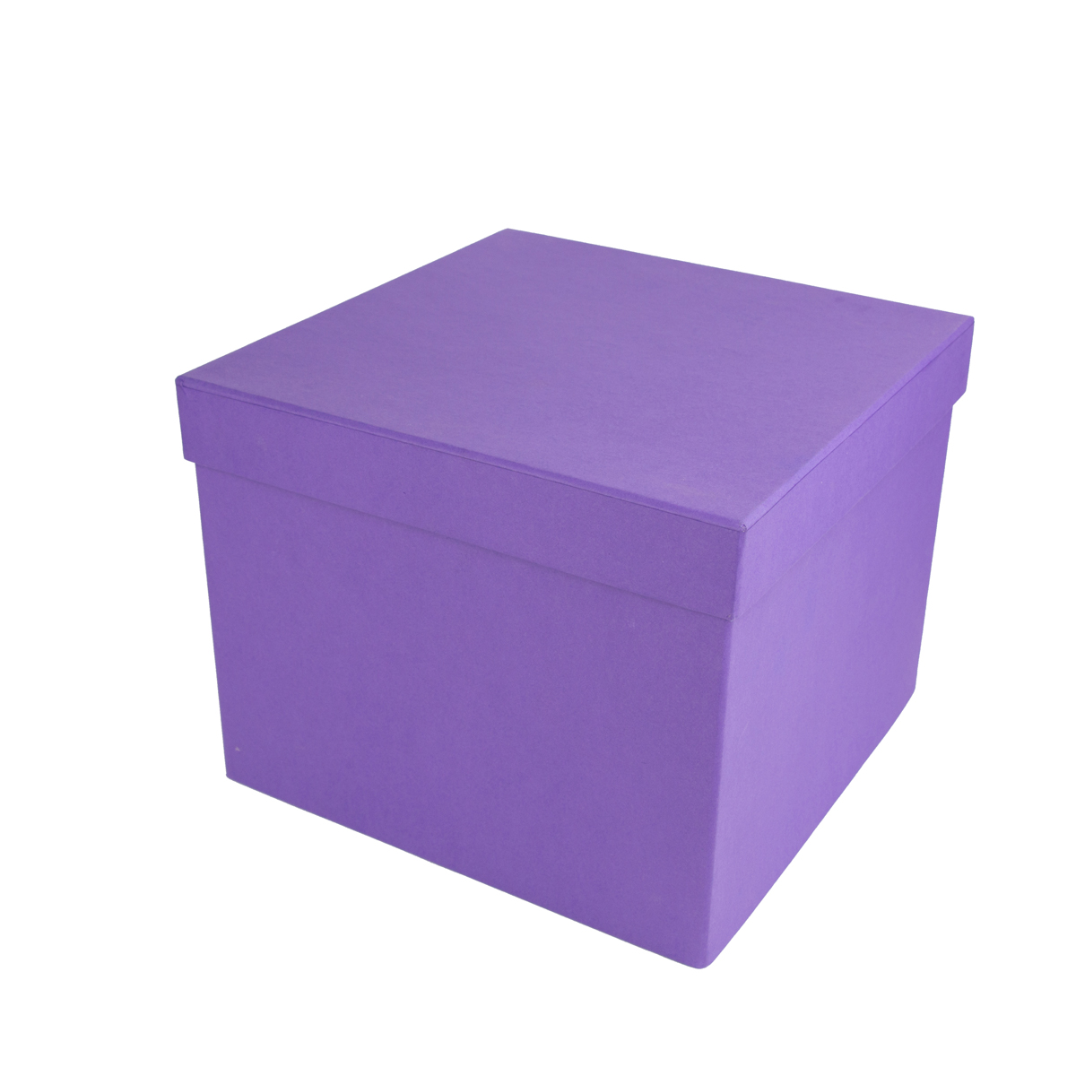
VIOLET BOX

Slide 3
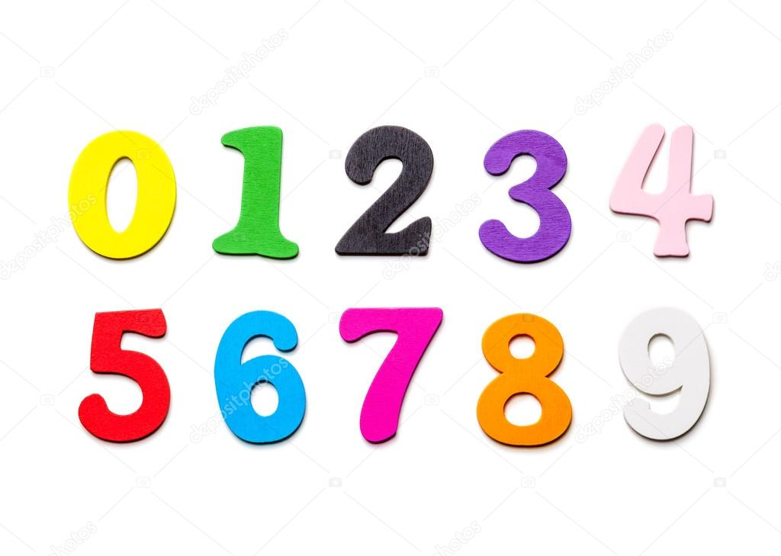

Slide 4
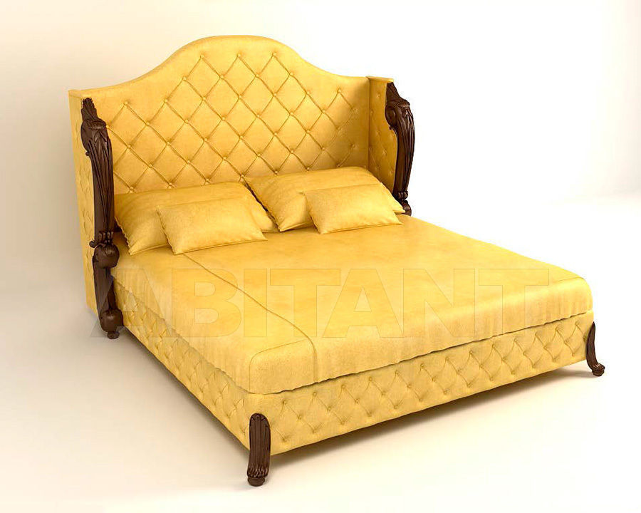
YELLOW BED

Slide 5
BROWN BOOK

Slide 6
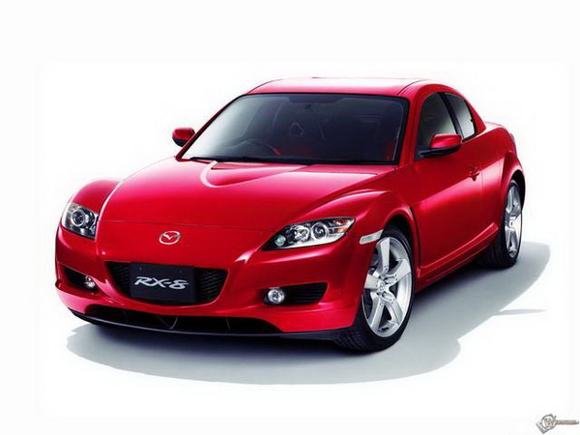
RED CAR

Slide 7
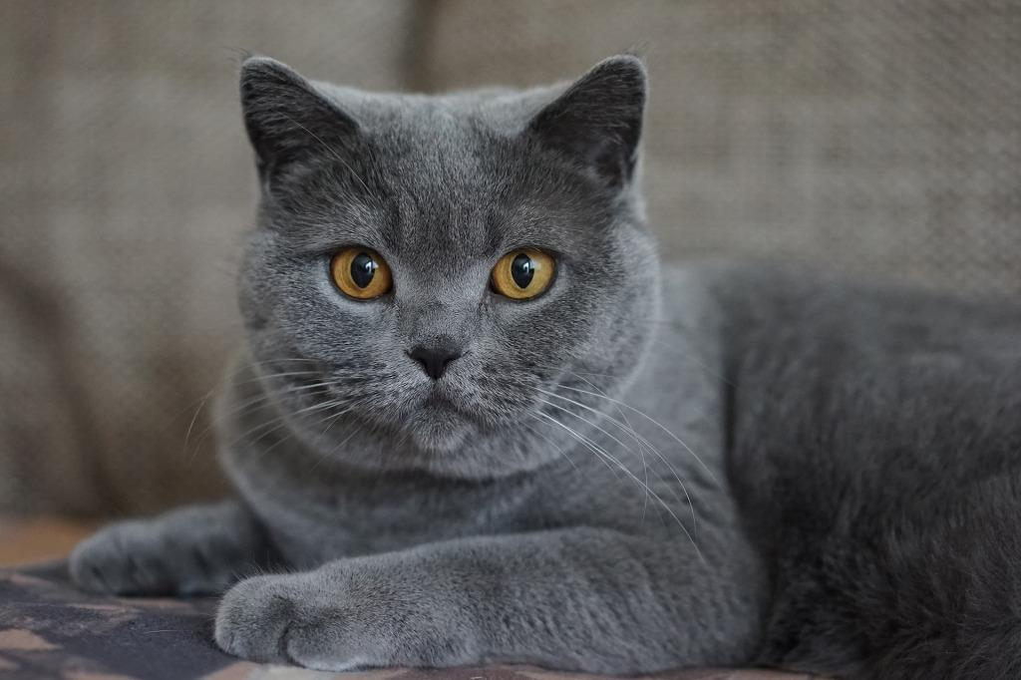
GREY CAT

Slide 8
BLUE CUP

Slide 9
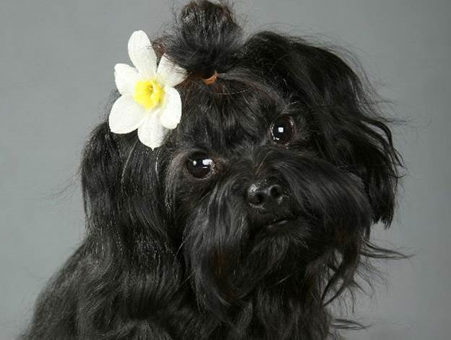
BLACK DOG

Slide 10
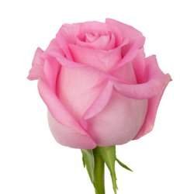
PINK ROSE

Slide 11
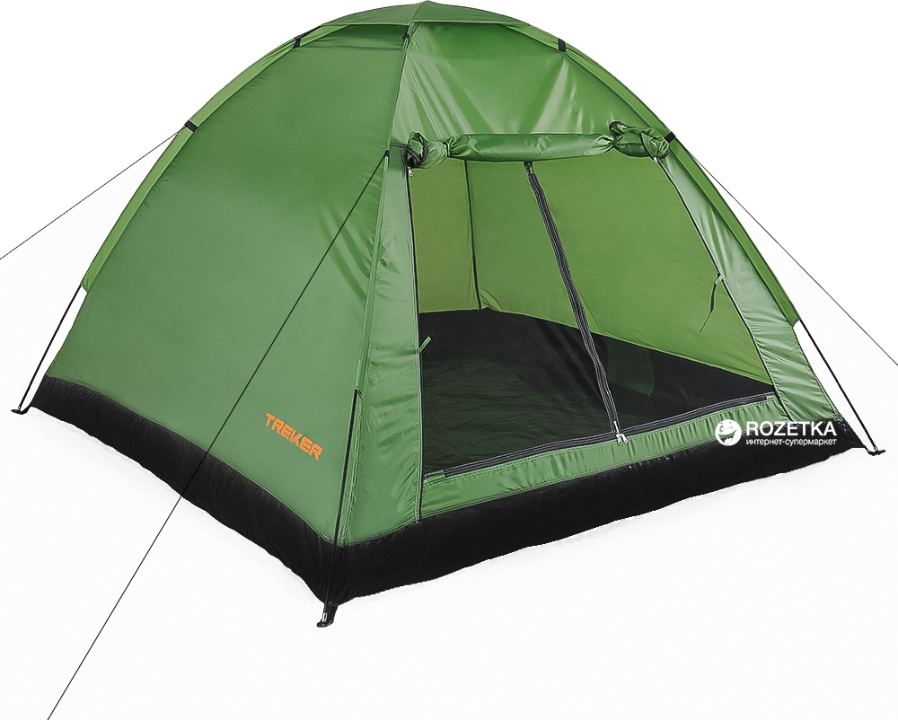
BROWN PEN
GREEN TENT

Slide 12
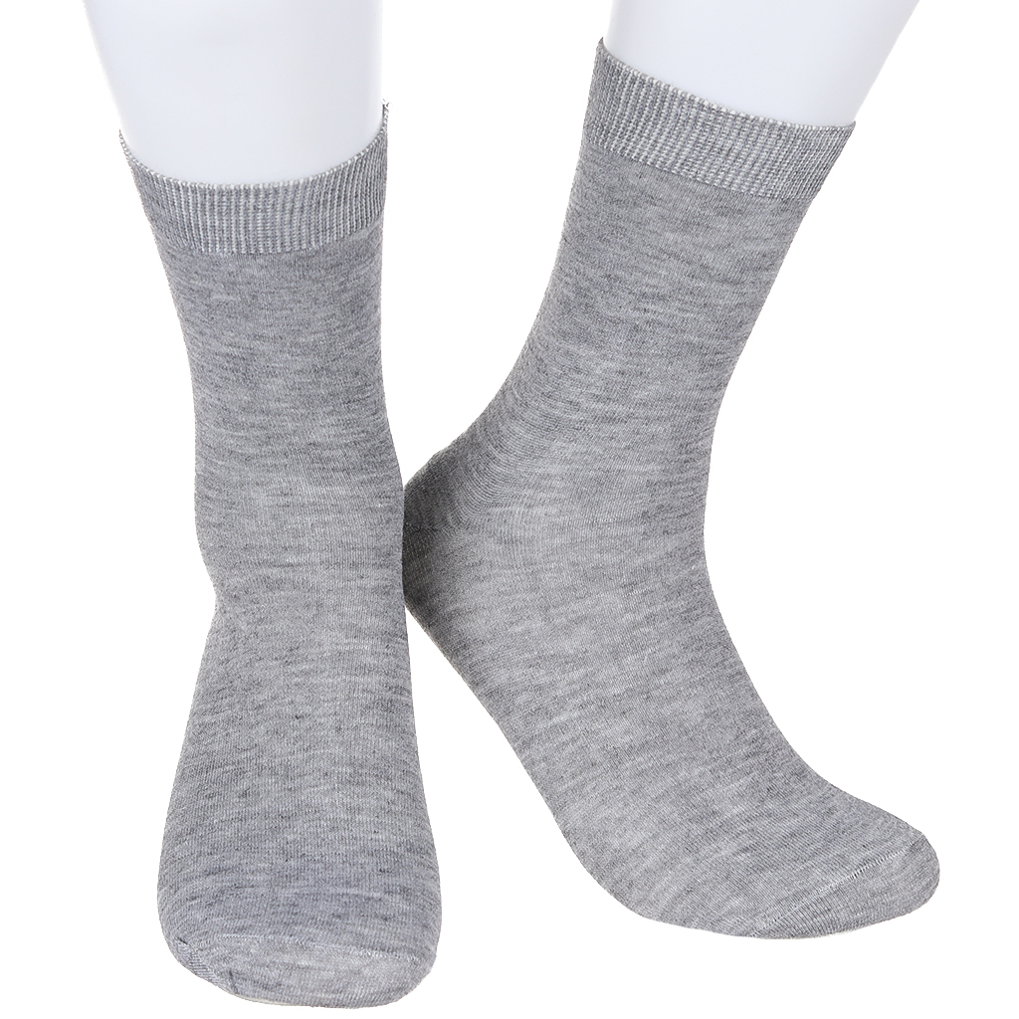
GREY SOCKS

Slide 13
WHITE SNOW

Slide 14
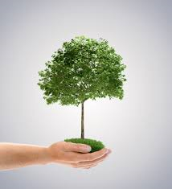
GREEN TREE
GREEN APPLE

Slide 15
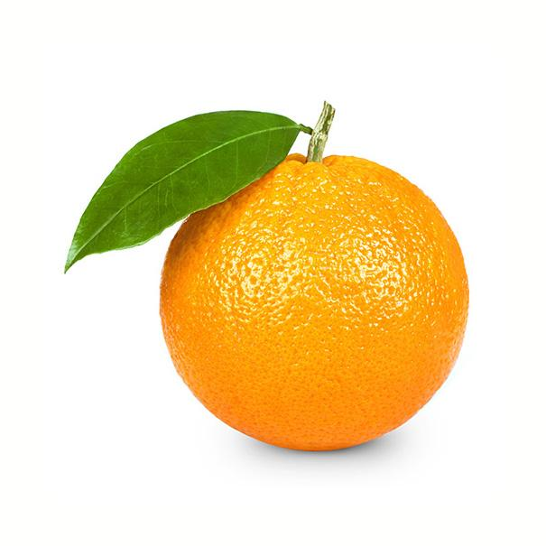
ORANGE ORANGE
RED APLLE

Slide 16
WHITE ROSE

Slide 17
GREY CLOUD

Slide 18
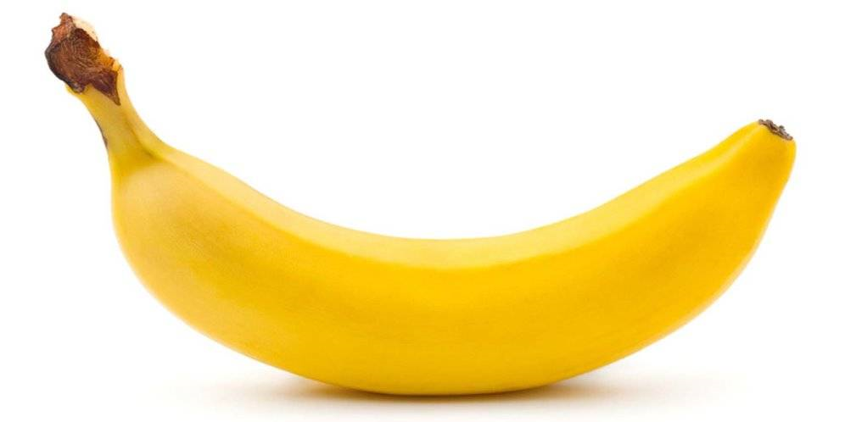
YELLOW BANANA

Slide 19
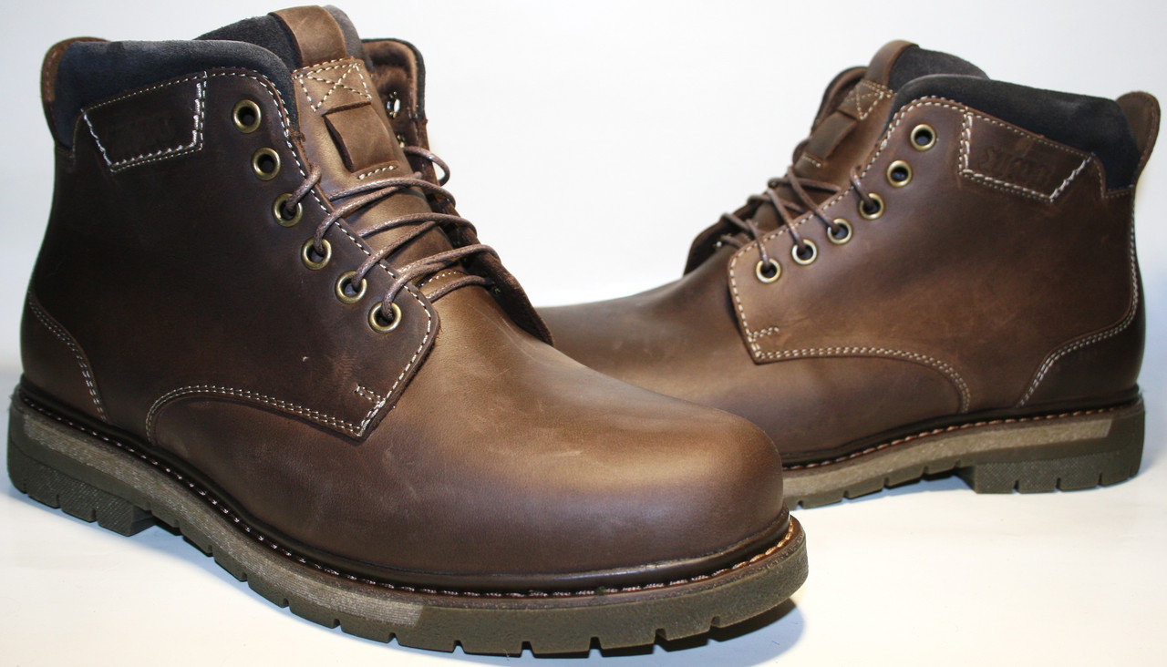
BROWN BOOTS

Slide 20
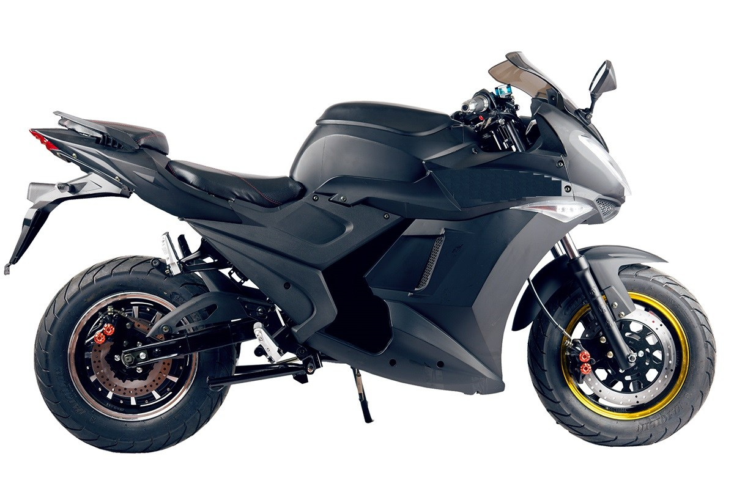
BLACK
BIKE

Slide 21
VIOLET BOX

Slide 22
WHAT DEFFERENCE?

Slide 23
RAINBOW

