Slide 1
Департамент образования Белгородской области
Областное государственное автономное профессиональное образовательное учреждение
«Губкинский горно-политехнический колледж»
ОТКРЫТЫЙ УРОК ПО ДИСЦИПЛИНЕ «ИНОСТРАННЫЙ ЯЗЫК»
ТЕМА: «AT THE AIRPORT. ON THE PLANE»
«В АЭРОПОРТУ. В САМОЛЕТЕ»
2 КУРС СПЕЦИАЛЬНОСТЬ 13.02.11 Техническая эксплуатация и обслуживание электрического и электромеханического оборудования (по отраслям)
ПРЕПОДАВАТЕЛЬ: ГОРЕНКО Н.Н.

Slide 2
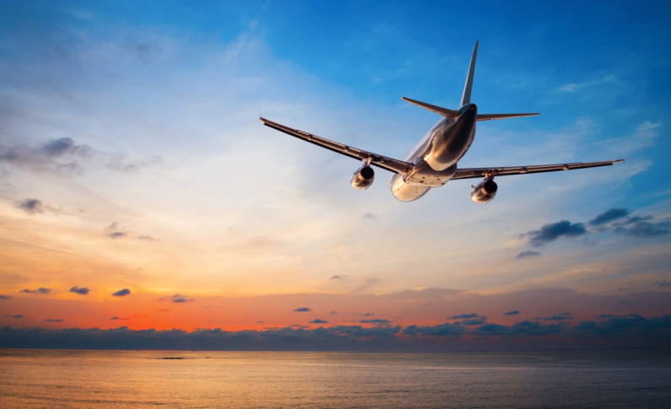
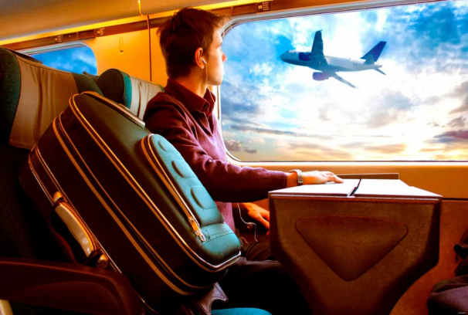
Today we are going:
to continue mastering the vocabulary from
the previous lesson;
to get acquainted with words, word expressions which
will be necessary for being
on the plane;
to review the grammar rules and phrases
from this topic.

Slide 3
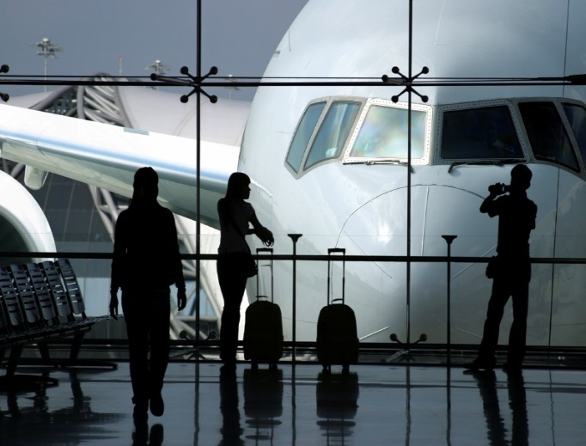
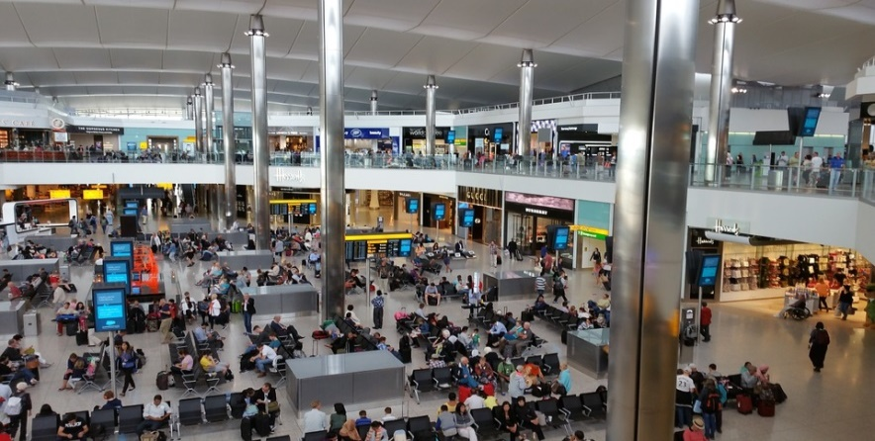
Classwork
The theme of our lesson is
“At the Airport“. “On the plane”

Slide 4
At the airport
CHECK - IN
FLIGHT
HAND LUGGAGE
ARRIVAL
DELAYED
DEPARTURE
GATE
CANCELED

Slide 5
AT THE AIRPORT
hand luggage/
cabin baggage
BOARDING PASS
AISLE
PASSPORT
CONTROL
LAYOVER
BOADING TIME
SEAT
excess baggage/
luggage

Slide 6
CHECKING HOMETASK
THE TASK: check your knowledge of the vocabulary. Put words from the vocabulary section into the correct sentences. For this reason take your PC tablets, switch them on, find the website named
www.videouroki.net/tests/
Insert number 3356541
as the number of the necessary test.

Slide 7
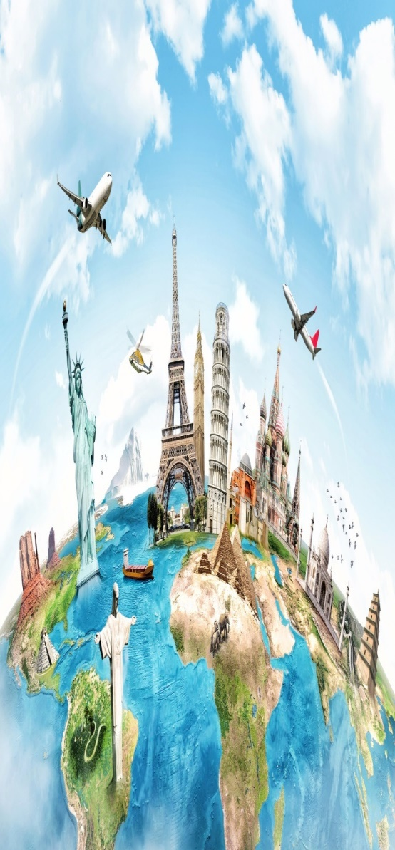
ANSWER THE FOLLOWING QUESTIONS:
- Do you like to travel?
- What are the main purposes of travelling?
- What kinds of transport can you name?
- What is your favorite mean of travelling?
- Why do you like to travel?
- What famous travellers do you know?
- Have you travelled anywhere?
- What places would you like to visit?
- Have you ever travelled by air?

Slide 8
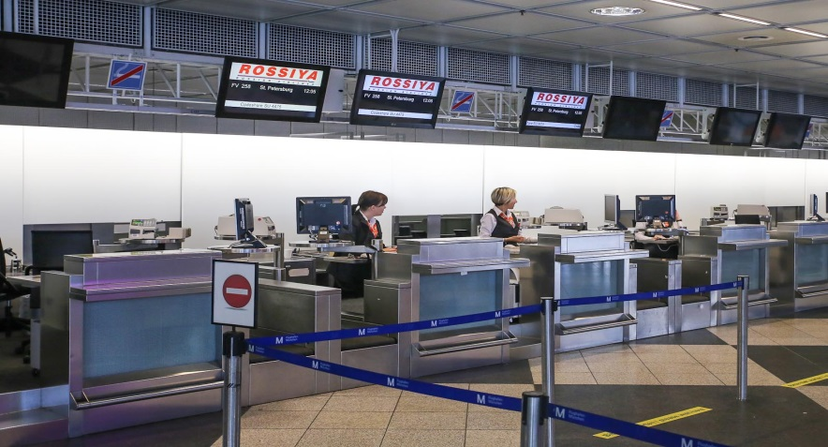
And now let’s watch the video
“Checking in at the Airport” paying attention to the words, word combinations and questions we have just fasten. The length of the video is 1.38. For this reason take your PC tablets, switch them on, find the website named
https://www.academy.englishdom.com/single-post/at-the-airport/
Connect your headphones.

Slide 9
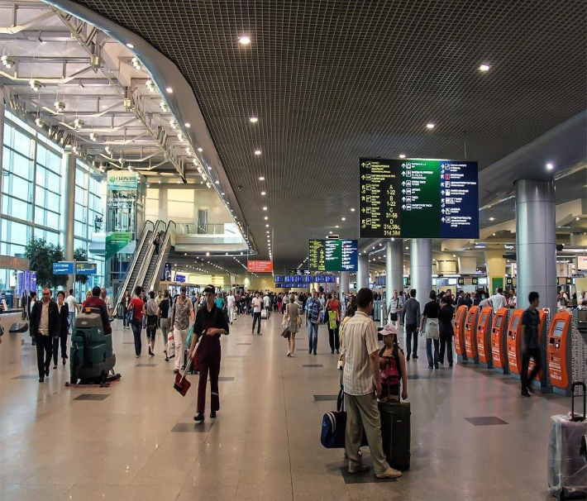
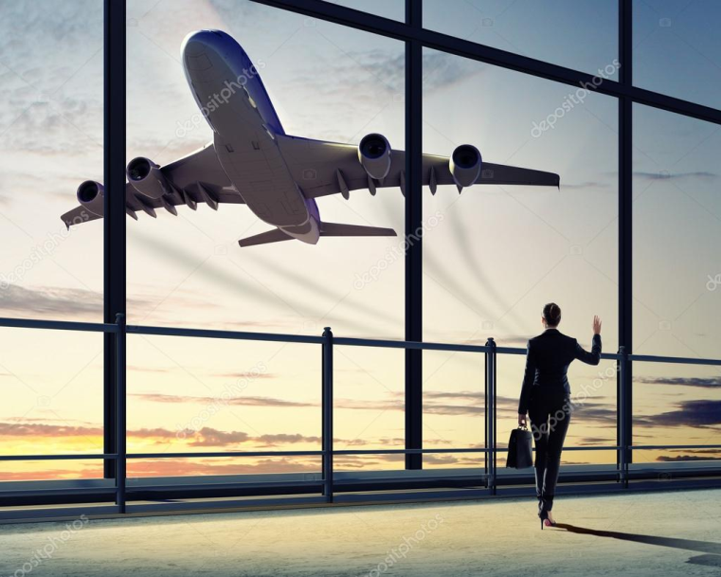
Let's assume you arrive at the airport to travel by air. For this reason take your PC tablets, switch them on, find the site named
www.5splusom-school.ru/audirovanie/zapisi_teksty_zadaniya/
Connect your headphones.
Text “Travelling by air”

Slide 10
Exercise 1. Answer the following questions according to the text:
Where can you buy an airline ticket?
What’s a “no-show"?
Why do airlines overbook their flights?
When do passengers get “bumped"?
When are security checks made, and what is searched?
Why do many passengers buy things at a duty-free shop?
Where can you put your hand baggage on the aircraft?
What percentage of the population is afraid of flying?

Slide 11
Exercise 2: Open the brackets using degrees of comparison of adjectives:
a) A cinema ticket is /cheap/ than a theatre ticket.
b) A train is /comfortable/ than an aircraft.
c) Los Angeles is /large/ than Chicago.
d) The blue skirt is /stylish/ than the pink one.
e) Jack is /reliable/ than Tom.
f) My bag is /heavy/ than yours.
g) Learning a language is / difficult/ than learning to drive a car.
h) You were /thin/ than before you went on holiday.

Slide 12
What we should or shouldn't do
when we hear these phrases?
Follow the safety instructions.
Put your clothes into the overhead compartment.
Place your carry-on bags under your seat.
Fasten your seat-belts.
Keep your seat-belts fastened during taxiing, take-off and landing.
Smoking is forbidden at all times.
Shut off your cell phones, laptops and any electronic gadgets.

Slide 13
HOMETASK:
Write about your experience of travelling by plane, or about an airport, or give useful tips for air passengers.

Slide 14
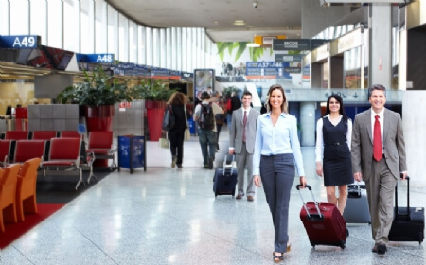
Let's finish the sentence:
Today I could …
- speak English,
- act out dialogues,
- answer questions,
- work in pairs,
- read English,
- speak in public,
- understand English speech,
- revise some words,
- be in the airport.

Slide 15
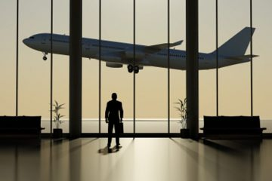
Our lesson is over.
Thank you for your work.
Good-bye.

