Slide 1
Crimes in the international law
The North-South Branch of the Federal State Budget Educational Institution of the Highter Education
the Russian State University of Justice
Work done by Polina Ditkovskaia
Student of the third course of Legal Faculty
Tutor: Sinina Anna Igorevna,
Candidate of Sciences (Philology)
Saint-Petersburg, 2020

Slide 2
Plan
The concept of the international criminal law;
The legal sources of the international criminal law;
The definition of international crimes;
The tipes of international crimes;
The definition of transnational criminality;
The tipes of transnational crimes;
The definition of legal assistance in criminal cases.

Slide 3
The concept of the international criminal law
The international criminal law is a system of the international legal principles and norms regulating cooperation of subjects of the international law in the fight against international, transnational and common criminal (with the presence of a foreign element) crimes.

Slide 4
The legal sources of the international criminal law
Today the rules of the international criminal law determined by international treaties. Such a tendency originates in the late 19th and early 20th century, when the crimes began to cross national borders and became an international problem. For example, Treaty of Versailles of June 28, 1919, provided for the tribunal of Kaiser Wilhelm II.

Slide 5
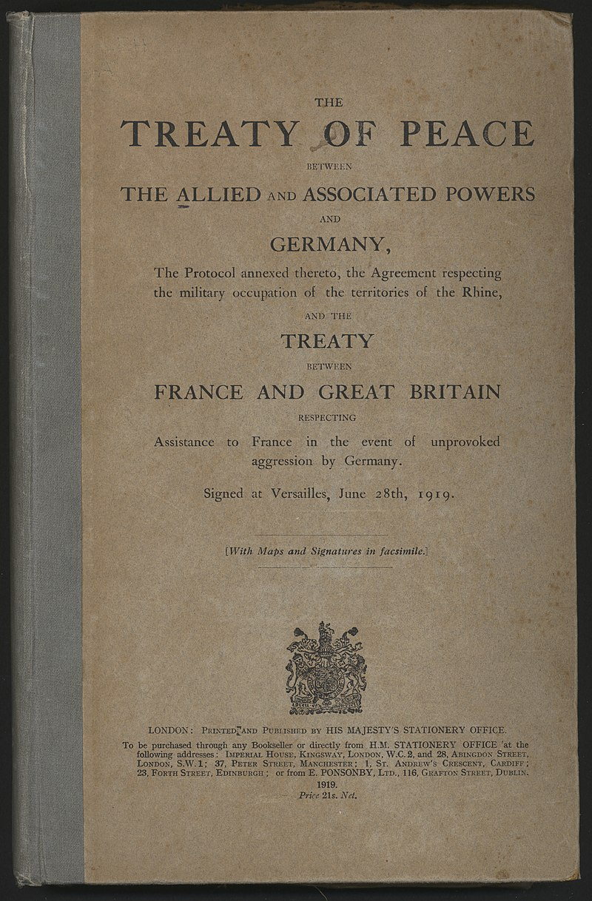

Slide 6
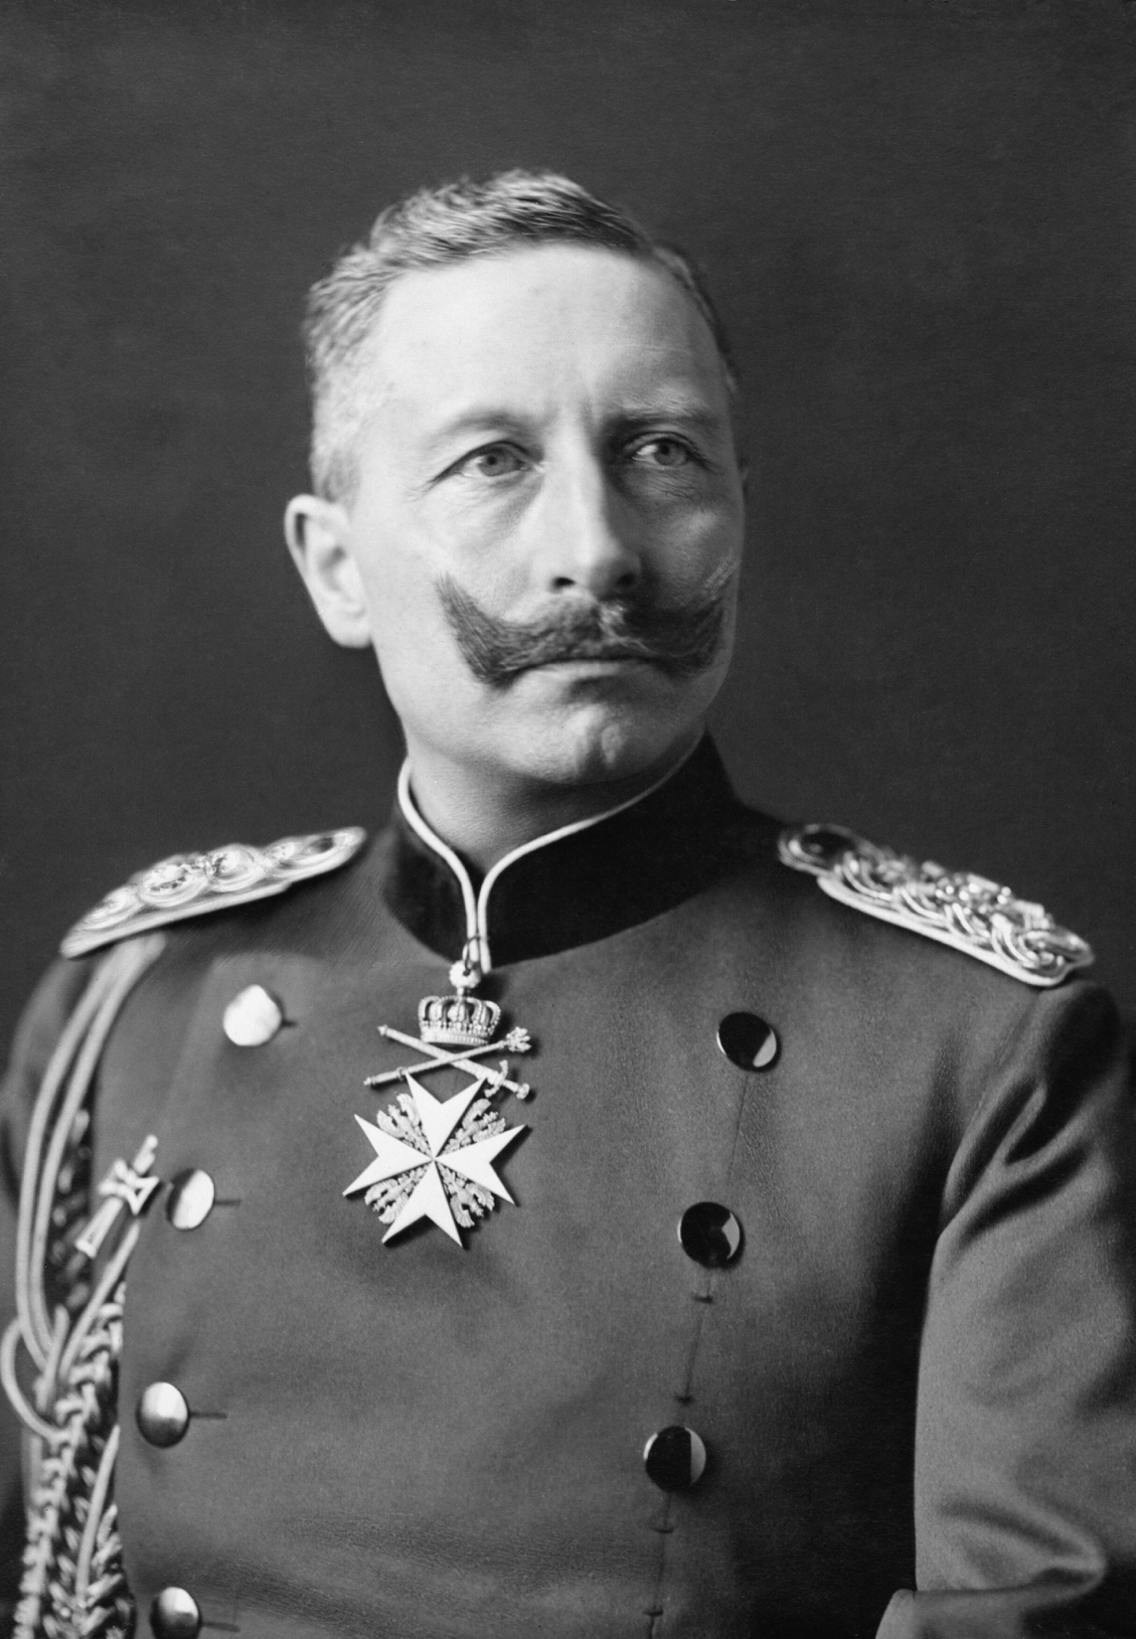

Slide 7
The sources of the international criminal law include international legal custom, too. At the time of the emergence and development of the norms of the international criminal law, custom played a crucial role in relations between countries: first of all, this applies to:
the rules of extradition of criminals;
the laws and customs of warfare;
the issues of delineation of the criminal jurisdiction of states.

Slide 8
In the context of the theme “crimes in the international law”, as mentioned adove, we can speak about:
the international crimes;
the transnational criminality;
the issues of mutual assistens and cooperation of countries in criminal proceeding.

Slide 9
The definition of the international crimes
In the doctrine of international law, international crimes are understood as the most serious and dangerous violations of the principles and norms of the international law that affect the global interests of humanity and pose a threat to international peace and security. Sometimes the term “crimes against the peace and security of mankind” is applied to this category of crimes.

Slide 10
The tipes of the international crimes
Rome Statute of the International Criminal Court, 1998, includes norms which provides for the following crimes:
crime of genocide;
crimes against humanity;
war crimes;
crime of aggression.

Slide 11
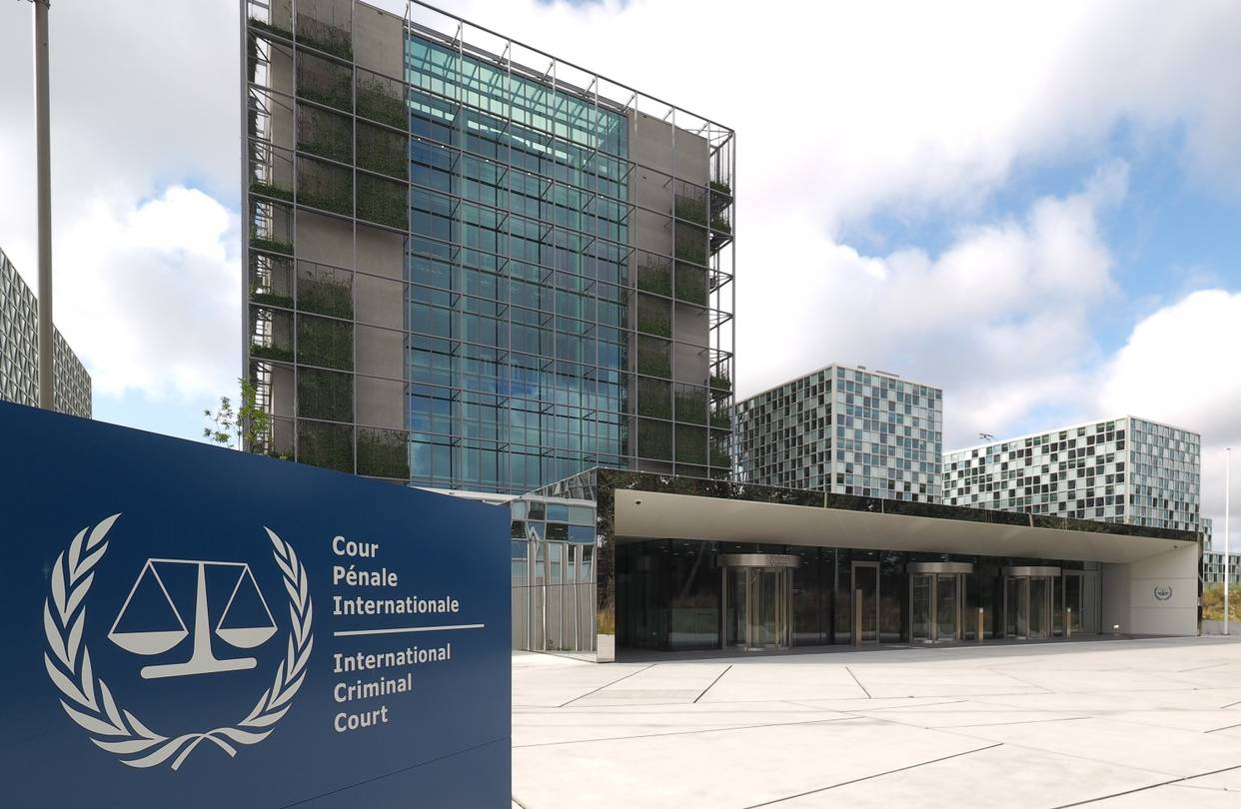

Slide 12
The definition of the transnational criminality
Transnational criminality is commonly understood as criminal activity (a set of transnational crimes) that goes beyond the national borders of at least one state and encroaches on the interests of at least two states protected by criminal law, carried out by its subjects, at least one of them, is not a state (as an example –the piracy off the coast of Somalia).

Slide 14
The tipes of the transinternational crimes
The report of the UN Secretary General at the eighth UN Congress on crime prevention classified transnational crimes into five main groups:
the transnational nature terrorism;
organized on an international basis the clan of the crime with the main objective of obtaining income;
economic crimes involving operations and transnational activities in two or more countries;

Slide 15
transnational illegal trade in art objects that are of great cultural and religious value of nation;
actions that violate ecological balance and state of the environment in more than one country through pollution.

Slide 16
The definition of the legal assistance in criminal cases
In the broadest sense legal assistance in criminal cases is the institute of the international law, whose norms regulate the execution of certain procedural actions (including detention, arrest and transfer the suspect) at the request of foreign law enforcement body in accordance with an international treaty or the reciprocity principle.

Slide 17
An example of such an international treaty might be European Convention on mutual legal assistance in criminal matters, 1959.

Slide 18
I hope you have enjoyed my presentation!

