Slide 1
The North-South Branch of the Federal State Budget
Educational Institution of the Higher Education
The Russian State University of Justice
Legislation and constitution of
Russia, the UK and the USA
Kirillov Filipp Pavlovich
Student of the third course of Legal Faculty
Tutor: Bashmakova Natalya Ivanovna, Candidate of Science (Pedagogy)
Saint-Petersburg,
2020

Slide 2
I. The United States of America
1. The US constitution
1.1. The Bill of Rights
1.2. Constitution’s features
2. Three Branches of Government
2.1 Legislative branch
2.2. Executive branch
2.3. Judicial branch
3. The US Legislation
II. The United Kingdom of Great Britain and
Northern Ireland
1. The British constitution
1.1. Parliamentary sovereignty
2. Power in the United Kingdom
3. Courts of the United Kingdom
III. The Russian Federation
1. Constitution of the Russian Federation
1.1. Provisions
1.2. Presidency
2. Legislative branch
3. Judiciary
Presentation structure:

Slide 3
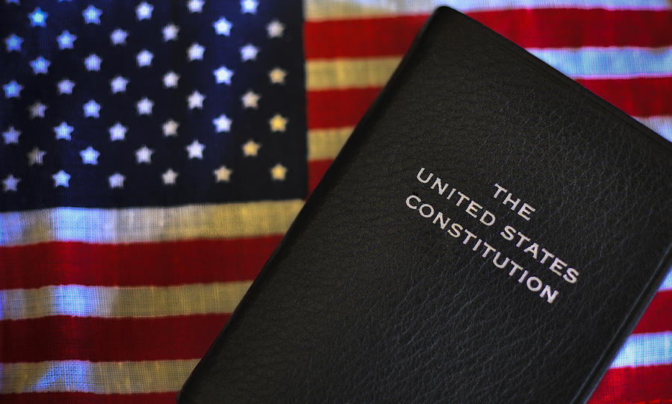
The US constitution
The form of the US government is based on the Constitution of 1787 which was adopted after the War of Independence
The US Constitution consists of 7 articles and 27 amendments.
The first 10 amendments are called the Bill of Rights and were adopted in 1791 under popular pressure.

Slide 4
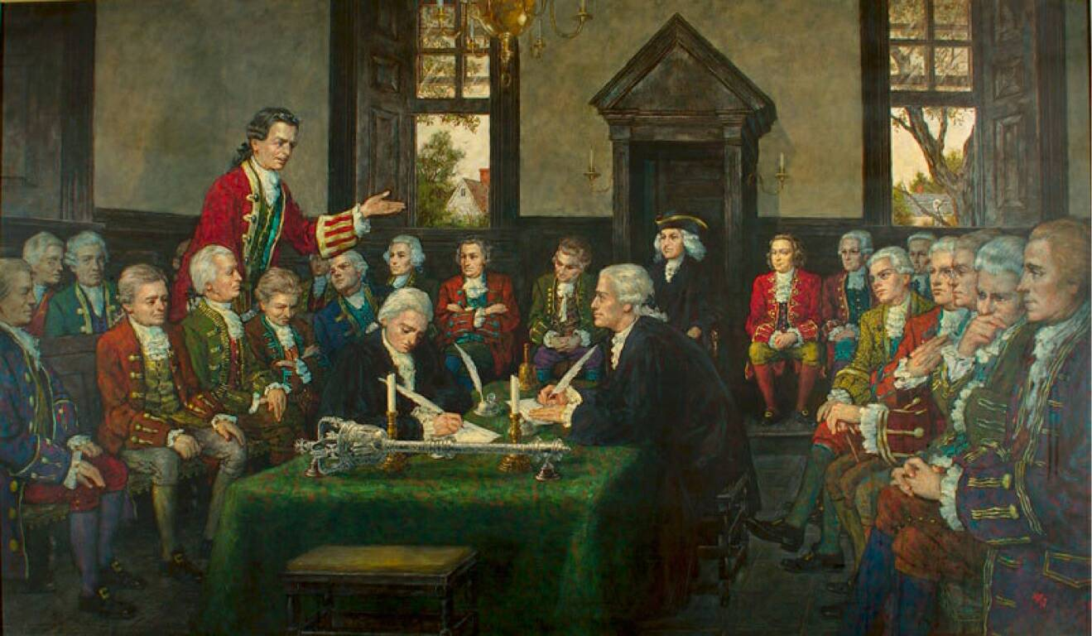
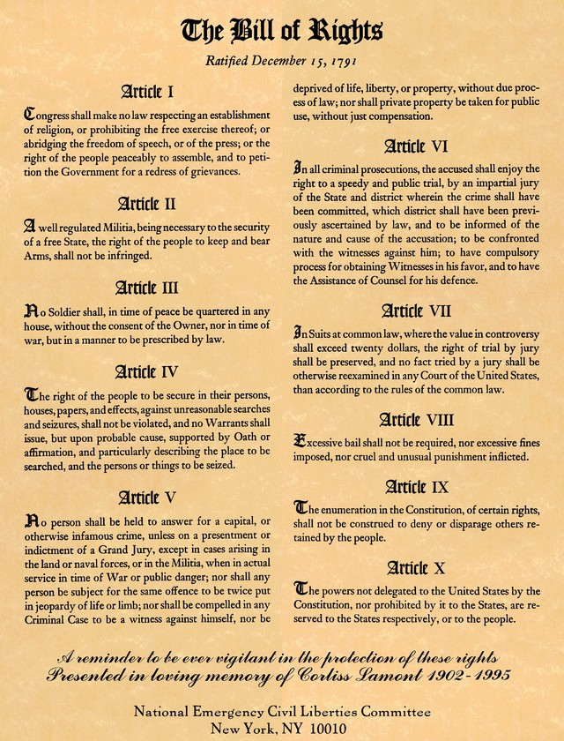
The Bill of Rights

Slide 5
The Bill of Rights is a series of limitations on the power of the United States federal government, protecting the natural rights and liberties, property including freedom of religion, freedom of speech, a free press, free assembly, and free association, as well as the right to keep and carry arms..
In federal criminal cases, it requires indictment by a grand jury for any capital crime, guarantees a speedy, public trial with an impartial jury composed of members of the state in which the crime occurred.

Slide 6
Constitution’s features
Key feature of the US Constitution is federalism - the division of power between the national government and the states. Another major feature of the Constitution is the principle of the separation of powers within the national government.
There is the system of checks and balances, which is each branch has certain duties to check the powers of the other branches. This system was meant to protect against the extremes since it makes compromise and consensus necessary.

Slide 7
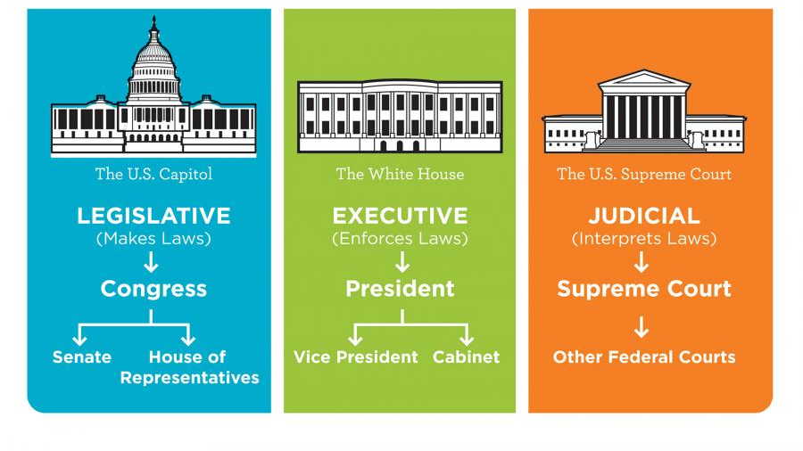
Three Branches of Government

Slide 8
Legislative branch
Legislative branch is called the Congress which consists of the Senate and the House of Representatives.
It is the responsibility of the Congress to propose and pass laws. In the system of checks and balances, Congress can refuse to approve Presidential appointments and can override presidential veto.

Slide 9
Executive branch
Executive branch consists of the President, the Vice President, the Cabinet and the 13 Departments, and also of the independent agencies. Its responsibility is to enforce laws.
According to the principle of checks and balances, the President has the power of veto to reject the bill of the Congress. He also appoints all Supreme Court Justices.

Slide 10
Judicial branch
Judicial branch consists of the Supreme Court, 11 Circuit Courts of Appeals and 94 District Courts. This branch explains and interprets laws and makes decisions in lawsuits.
It has the power over the other two branches and according to the principle of checks and balances can declare their actions and laws unconstitutional in case they violate the principles of the Constitution.

Slide 11
The US Legislation
Congress has enacted approximately 200–600 statutes during each of its 115 biennial terms, so that more than 30 000 statutes have been enacted since 1789.
At the federal level in the United States, legislation consists exclusively of Acts passed by the Congress of the United States and its predecessor, the Continental Congress, that were either signed into law by the President or passed by Congress after a presidential veto.
Legislation is not the only source of regulations with the force of law. However, most executive branch and Judicial Branch regulations must originate in a congressional grant of power.

Slide 12
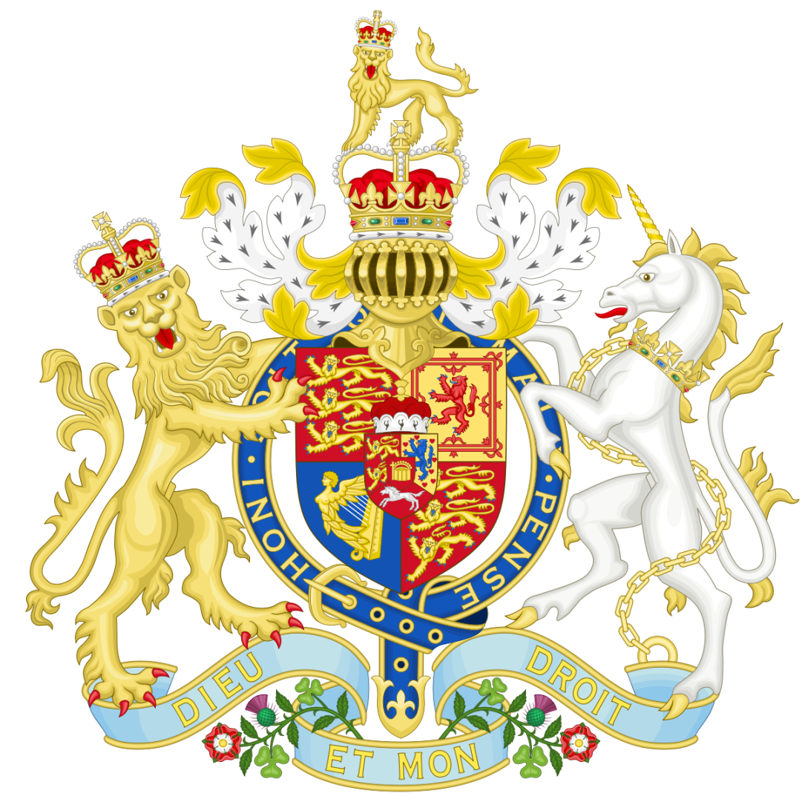
THE BRITISH CONSTITUTION
British Constitution is unwritten unlike the constitution in America or the proposed European Constitution, and as such, is referred to as an uncodified constitution in the sense that there is no single document that can be identified as Britain's constitution.
The British Constitution can be found in a variety of documents. The main ones are: Statutes (the Magna Carta of 1215 and the Act of Settlement of 1701), Acts of Parliament; customs and traditions, political conventions, case law; constitutional matters decided in a court of law.

Slide 13
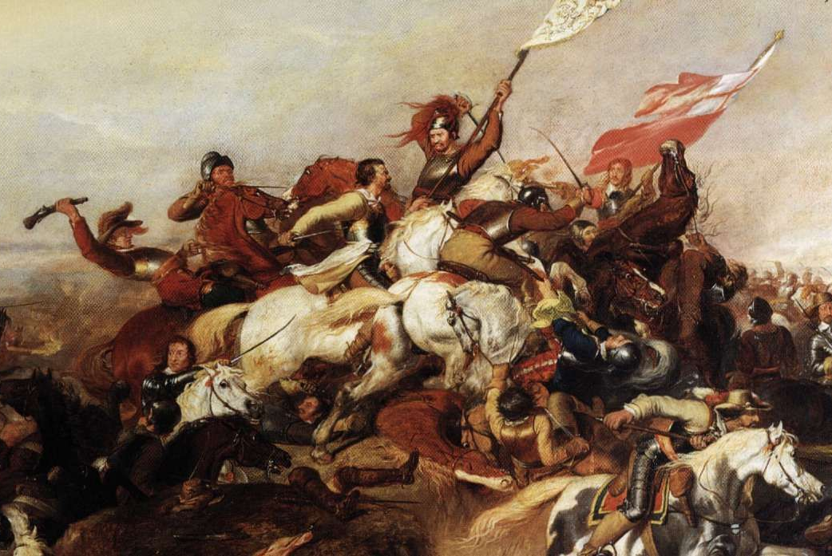
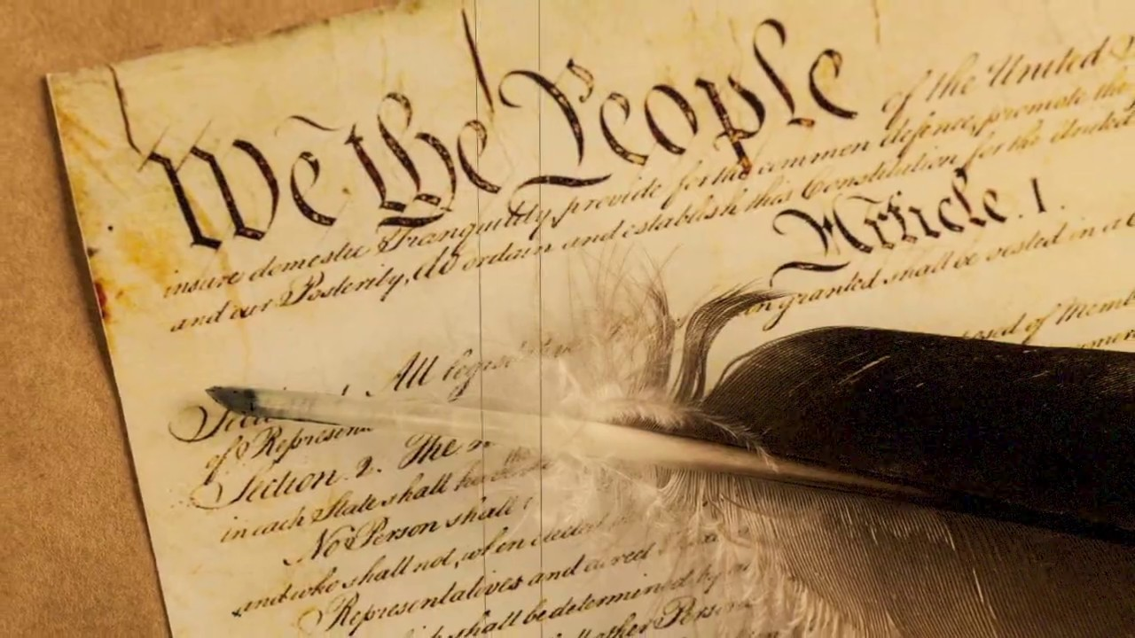
Parliamentary sovereignty
Since the English Civil War, the core principle of the British constitution has traditionally been the doctrine of parliamentary sovereignty, according to which the statutes passed by Parliament are the UK's supreme and final source of law. It follows that Parliament can change the constitution simply by passing new Acts of Parliamentto to be followed by the Royal Assent.
There is some debate about whether this principle remains entirely valid today, in part due to the UK's European Union membership.

Slide 14
Power in the United Kingdom
According to the doctrine of parliamentary sovereignty, Parliament may pass any legislation that it wishes. There are many Acts of Parliament which themselves have constitutional significance. For example, Parliament has the power to determine the length of its own term. However, the Sovereign retains the power to dissolve parliament at any time on the advice of the Prime Minister. Parliament also has the power to change the structure of its constituent houses and the relation between them. Consists of the Sovereign, the House of Commons and the House of Lords. All the legislation must receive the approval of the Sovereign (Royal Assent). Following the accession of the UK to European Economic Community (now the European Union) in 1972, the UK became bound by European law and more importantly, the principle of the supremacy of European Union law.

Slide 15
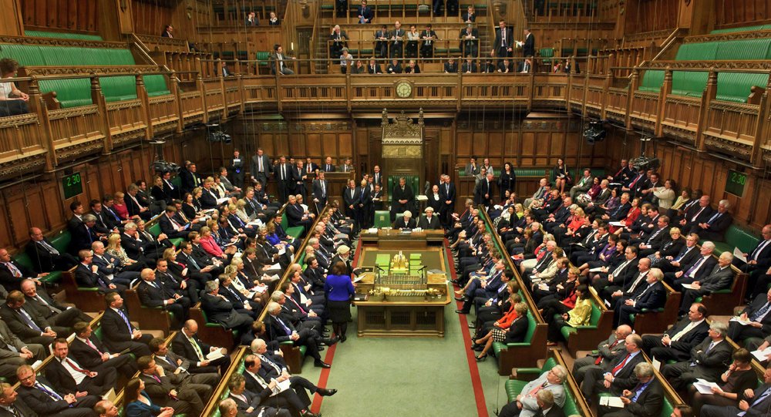
House of Commons alone possesses the power to pass a motion of no confidence in the Government, which requires the Government either to resign or seek fresh elections. Such a motion does not require passage by the Lords, or Royal Assent. Parliament traditionally also has the power to remove individual members of the government by impeachment. By the Constitutional Reform Act 2005 it has the power to remove individual judges from office for misconduct.
The Sovereign through Her Majesty’s Government exercises executive power in the United Kingdom. The monarch appoints a Prime Minister as the head of Her Majesty's Government in the United Kingdom. The Prime Minister then selects the other Ministers, which make up the Government. As in some other parliamentary systems of government, the executive is answerable to Parliament.

Slide 16
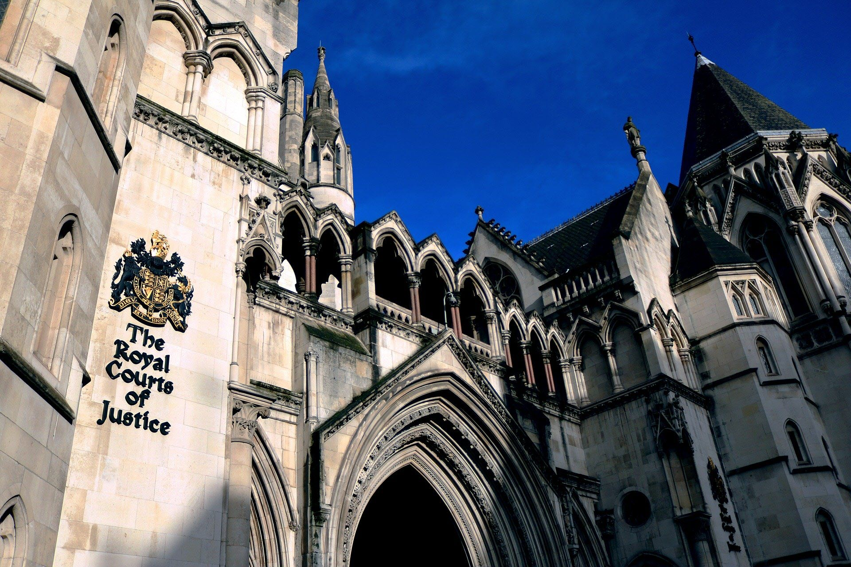
Courts of the United Kingdom
Courts of the United Kingdom are separated into three separate jurisdictions serving England and Wales, Scotland and Northern Ireland, as the United Kingdom does not have a single unified judicial system.
Constitutional Reform Act 2005 created a new Supreme Court of the United Kingdom to take over the judicial functions of the House of Lords and devolution cases from the Judicial Committee of the Privy Council. The Supreme Court began work in 2009, and serves as the highest court of appeal in England and Wales and in Northern Ireland, and for civil cases in Scotland. The High Court of Justiciary will remain the court of last resort in Scotland for criminal cases.

Slide 17
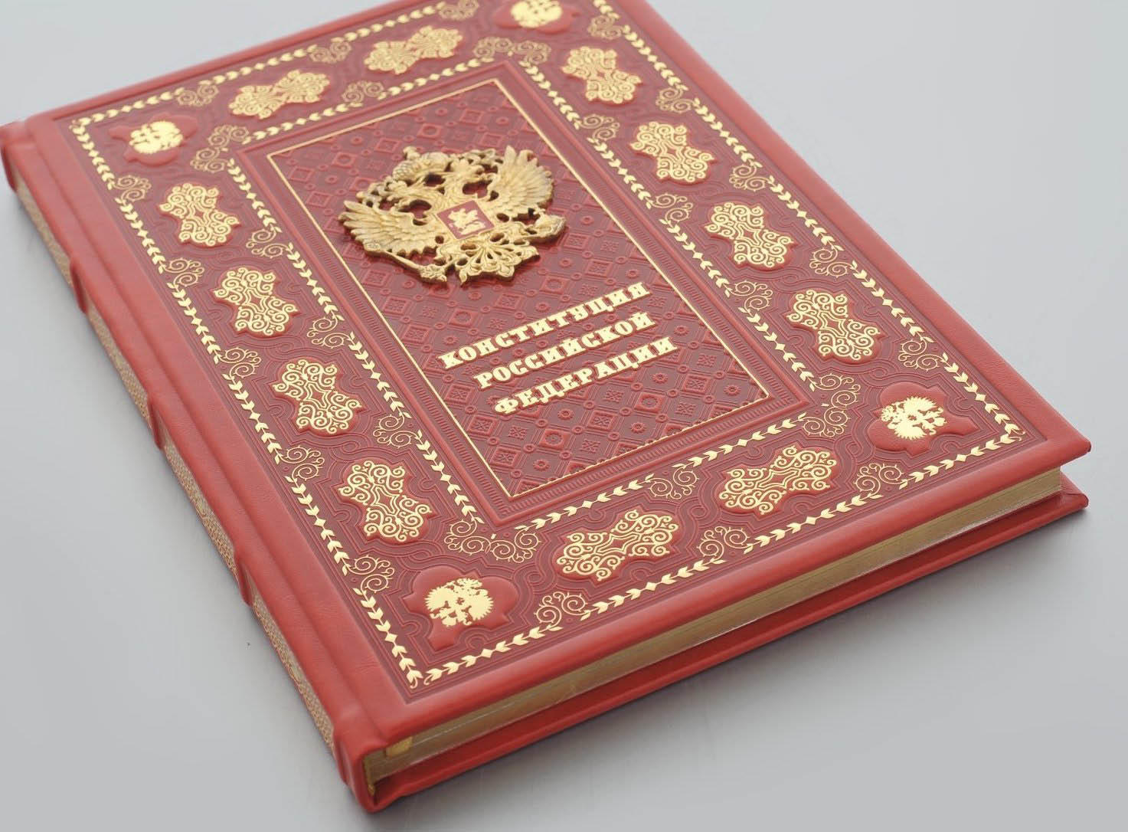
Constitution of the Russian Federation
The current Constitution of the Russian Federation was adopted by national referendum on December 12, 1993. Russia's constitution came into force on December 25, 1993, now of its official publication, and abolished the Soviet system of government. The current Constitution is the second most long-lived in the history of Russia, behind the Constitution of 1936.

Slide 18
Provisions
Especially on human rights and fundamental freedoms, the Constitution provides for human rights and freedom of citizen according to the universally recognized principles and norm of international law as well as the Constitution and affirms that the listing in the Constitution of the Russian Federation of the fundamental rights and freedom shall not be interpreted as a rejection and derogation of other universally recognized human rights and freedom.

Slide 19
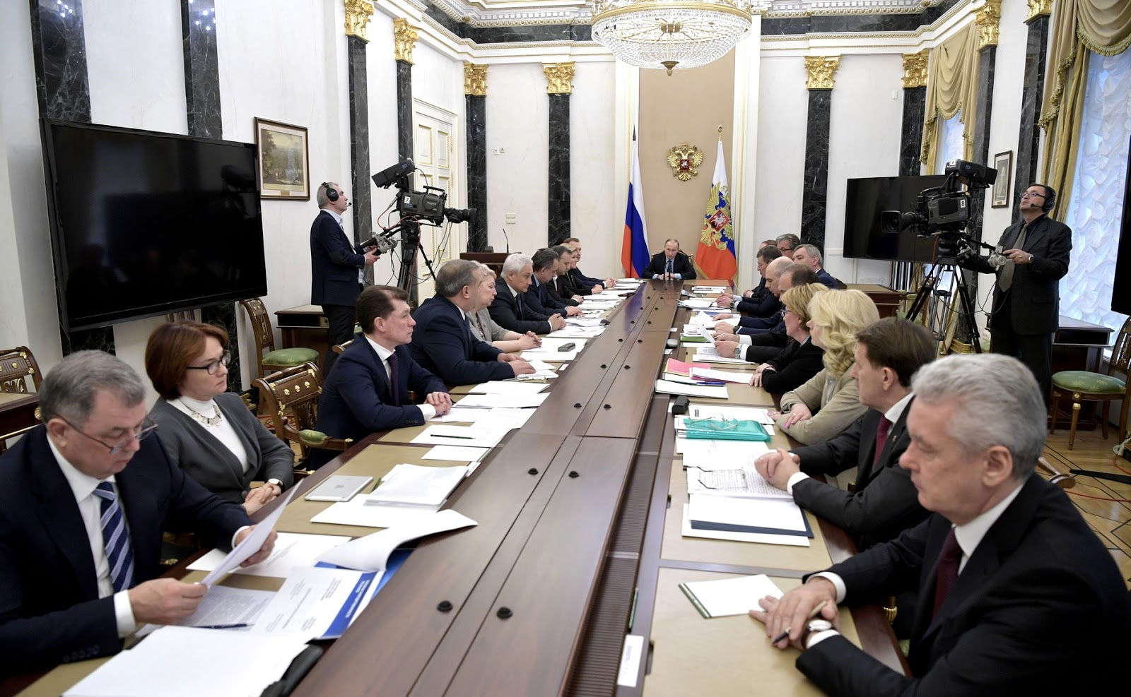
Presidency
The Constitution of the Russian Federation specifies that the President is the Russian head of state, setting domestic and foreign policy and representing Russian both within the country and internationally. While the original constitution stipulated a four-year term and a maximum of two terms in succession, the current constitution decrees a six-year term.

Slide 20
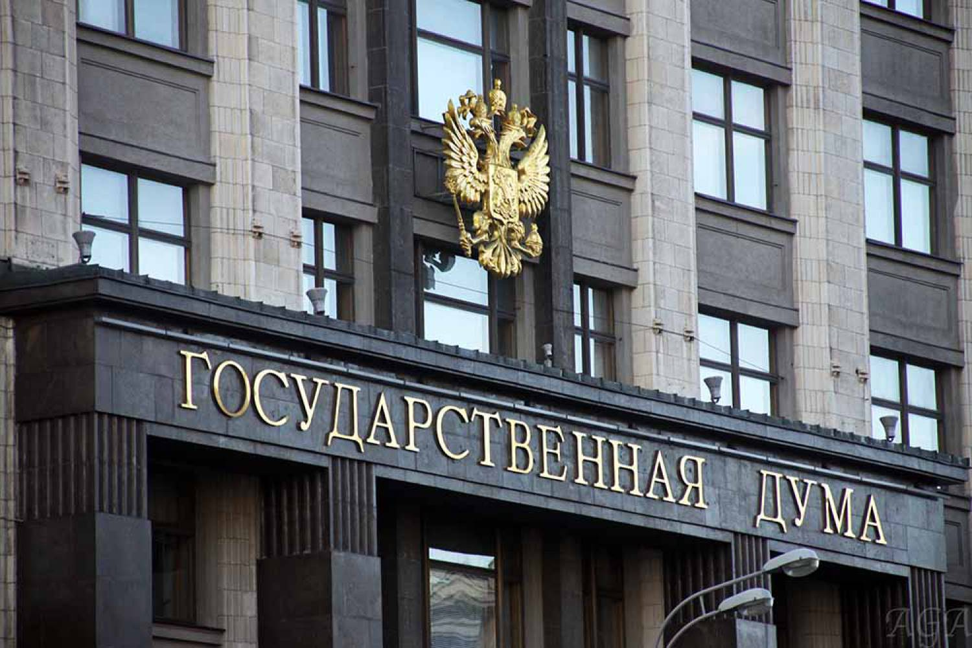
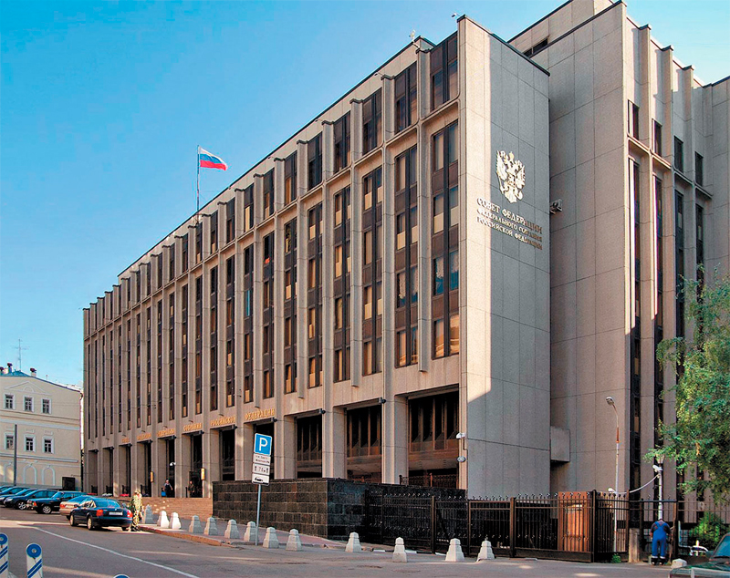
Legislative branch
The legislature is represented by the Federal Assembly of Russia, which consists of two chambers: the State Duma – the lower house, and the Federation Council – the upper house. The two chambers possess different powers and responsibilities, while the State Duma is of more significance, as the State Duma carries the main responsibility for passing federal laws.

Slide 21
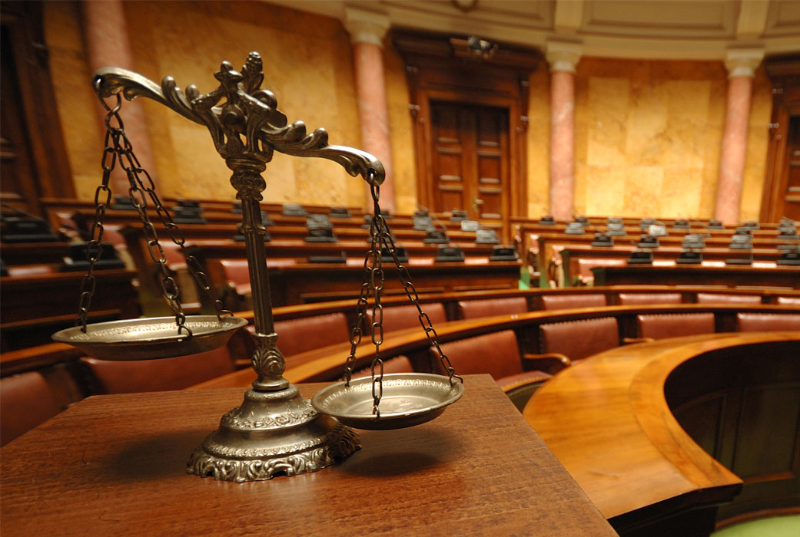
Judiciary
The constitution provides for judicial immunity, lifetime appointments/"irremovable" justices, and the supremacy of the courts to administer justice, and affirms that judges need only submit to the constitution and the federal law. Additionally, Article 123 provides for open and fair trials, as well as equal application of the law. Three courts are delineated Constitution Court of the Russian Federation, the Supreme Court of the Russian Federation, the Higher Arbitration Court, each "Appointed by the Council of the Federation upon the proposals by the President".

Slide 22
Thank you for your attention!

