Slide 1
THE AMERICAN JUDICIAL SYSTEM
The North-South Branch Federal State Budget
Education Institution of the Higher Education the Russia
State University of Justice
Work done by Mark Okulov
Student of the third course of Legal Faculty
Tutor: Sinina A. I.
Candidate of Science (Philology)
Saint-Petersburg, 2020

Slide 2
PLAN
DEFINITION
JURISDICTION
APPEAL
SUPREME COURT
FIRST ACT
VOTES
MAKING DECISIONS
SYSTEM IN GENERAL
THE END

Slide 3
The US judicial system is a system of interconnected judicial and administrative authorities that administer justice in the United States of America and administer the judiciary.

Slide 4
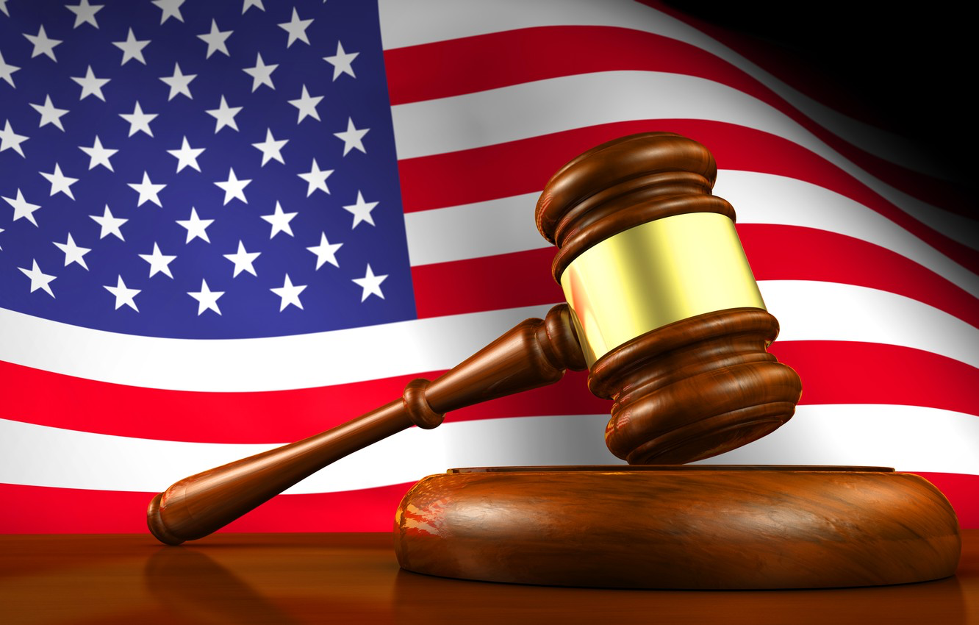
Each system also has a smaller number of intermediate appellate courts. These courts hear appeals from the trial courts.
Each judicial system has a number of courts of original jurisdiction, in which cases are originally filed and tried. The jurisdiction of these trial courts can be both geographically and subject matter based.

Slide 5
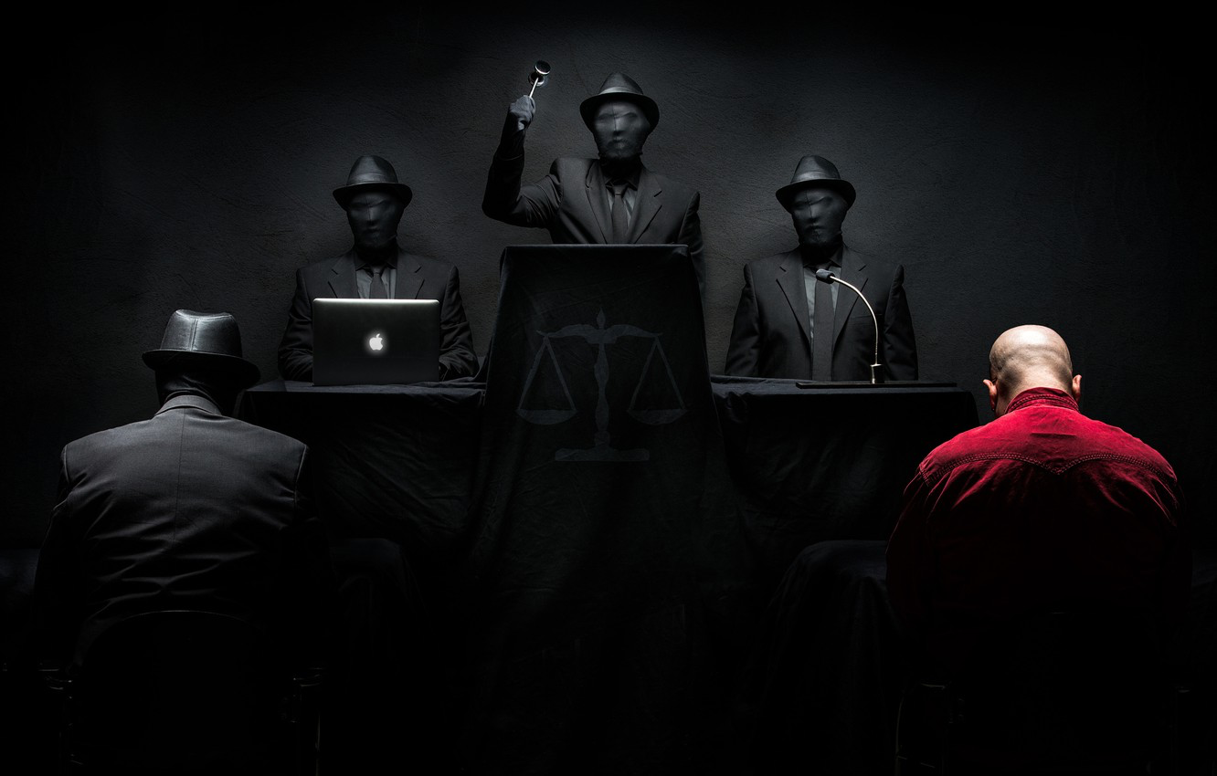
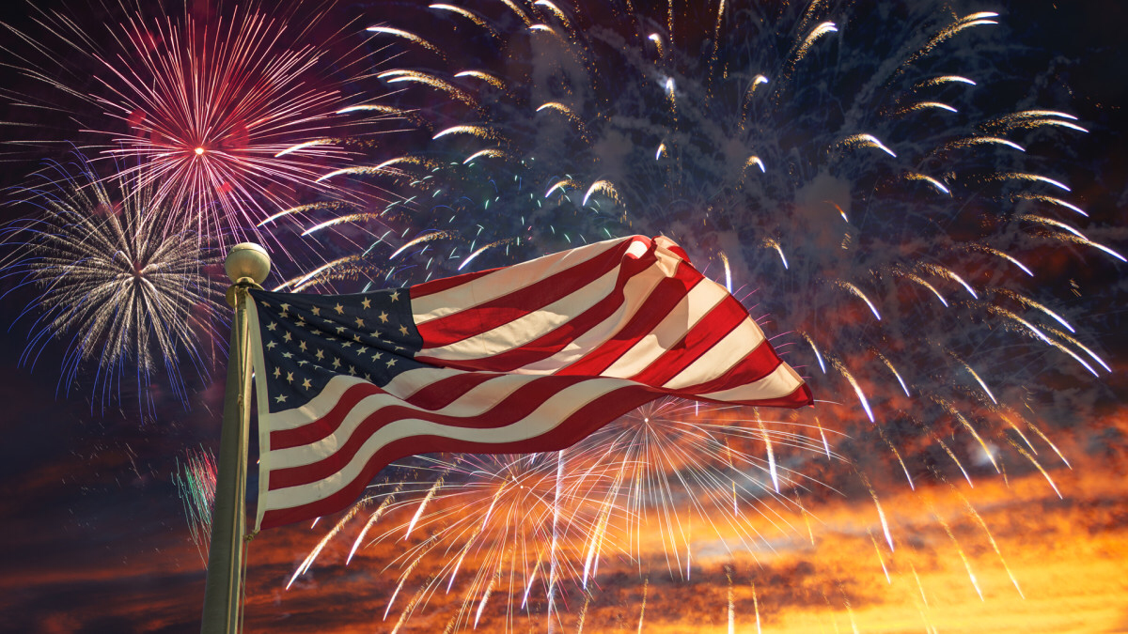
An appeal is a claim by the losing party that the lower court has made a mistake of law.
Usually, a losing party is entitled to one appeal as a matter of right.

Slide 6
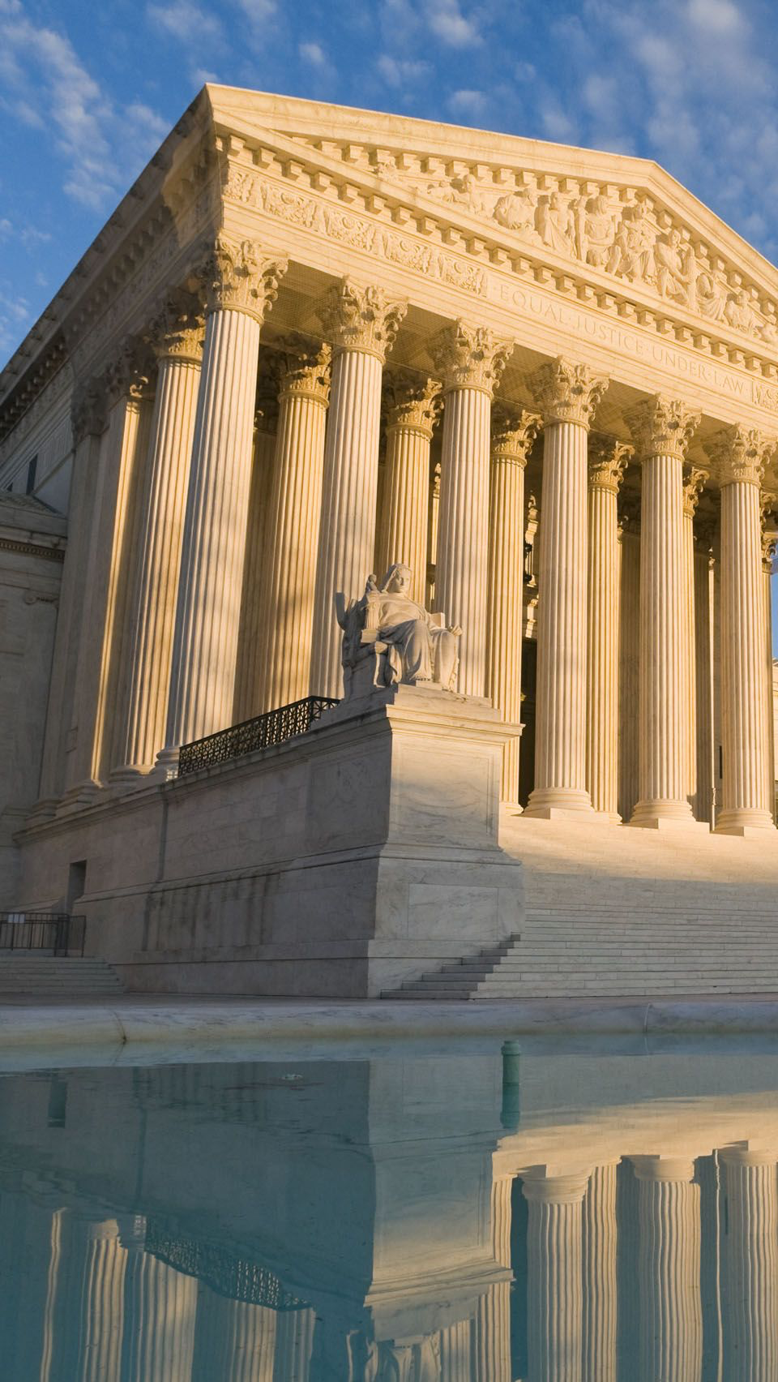
Each court system also has a supreme court, which hears appeals from the appellate courts. Appeals to the Supreme Court are usually discretionary, that is the court may choose whether or not to hear the appeal.

Slide 7
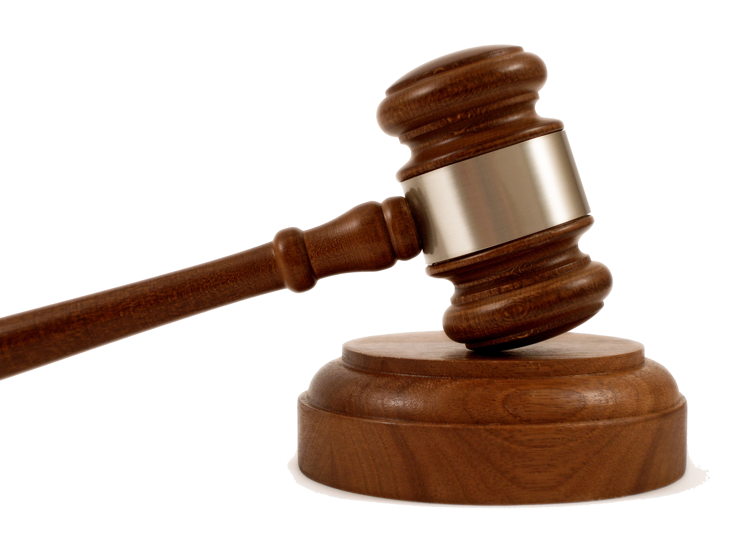
As one of its initial acts, the first Congress established not only the Supreme Court, but also a system of trial courts (District Courts) and intermediate Appeals Courts (Courts of Appeal). The Supreme Court has nine justices.
At present, the United States is divided into 91 districts, each with a District Court staffed by between two and 28 judges. There are 13 Courts of Appeal with between six and 28 judges each. Courts of Appeal normally sit in panels of three judges to hear cases.

Slide 8
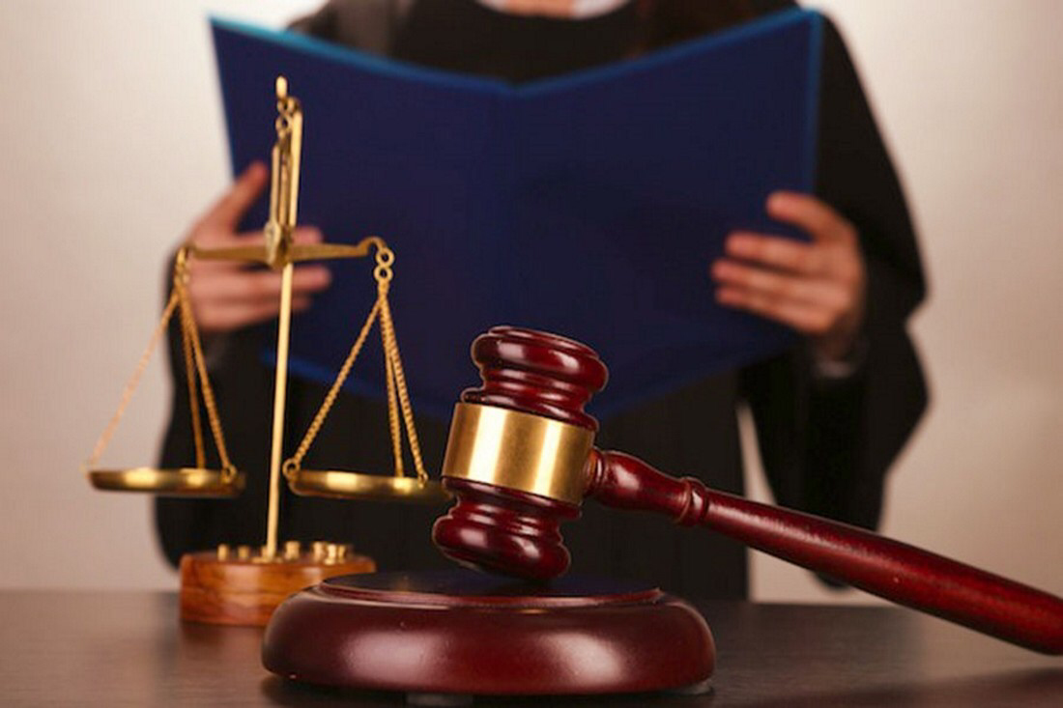
The Court has total discretion as to whether it wants to hear a particular case or not. It takes four votes from the nine justices to grant the writ of certiorari and hear the case. The Court usually basis its decision on the importance of the legal issue involved to the country as a whole.
All appeals to the United States Supreme Court, whether from a state Supreme Court or from a federal Court of Appeals, are discretionary. The person bringing the appeal (called the petitioner) files a petition for a writ of certiorari with the Supreme Court.

Slide 9
When issuing decisions, all courts must follow binding precedent -- that is their decisions must follow any rulings made by courts above them. On questions of the interpretation of the United States Constitution and statutes passed by Congress, the United States Supreme Court has the final say. All other courts, both federal and state, must follow any precedent set by the Supreme Court.

Slide 10
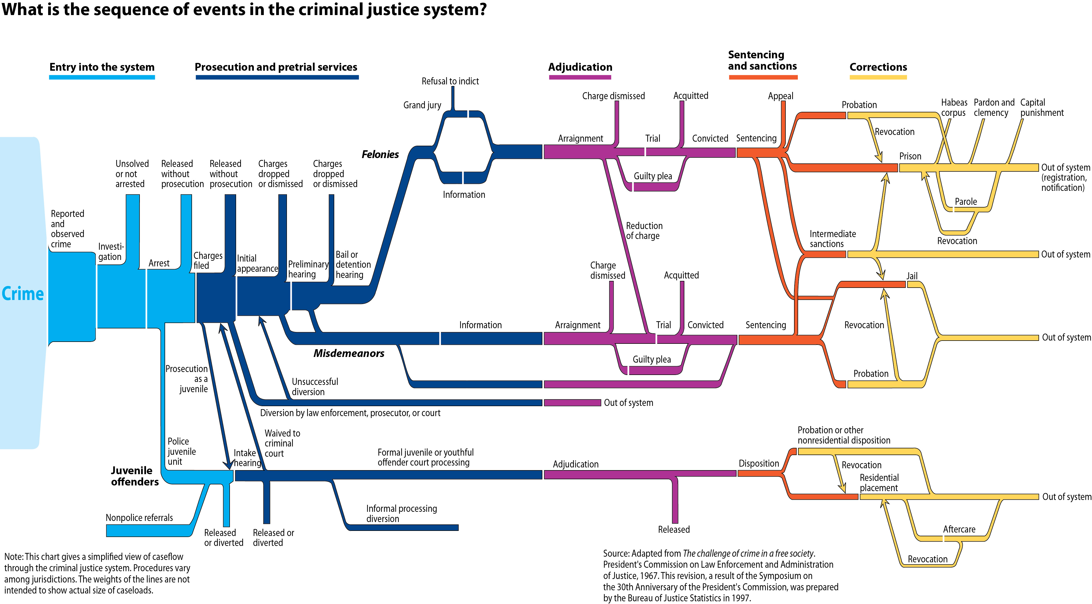

Slide 11
I HOPE THAT YOU HAVE ENJOYED

