Slide 1
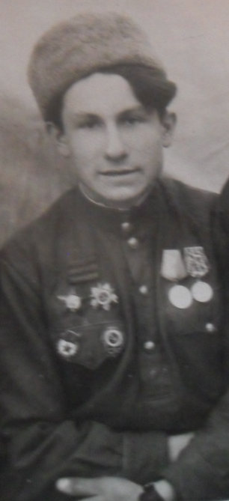
My grandfather - Scout
Prepared Shalygin Roman, a disciple of 8 Class A, MOU school number 13 UIOP, GO Zhukovsky, Moscow region. April 2015

Slide 2
My grandfather - Scout
My great-grandfather Mikhail Popov, born October 21, 1924, in 1942 he joined the Soviet Army, after graduating from the Moscow School of machine-gun got to the front at Kharkov in Raisin.
There were heavy fighting retreat for p. Seversky Donets.
After being wounded in the fighting 41 Guards Division scout.
Received the first combat award: Medal "For Courage".
In August 1943 in Chuguev for the suppression of the firing point and the Nazis taking the "language" was awarded the Order "Red Star".
In the battle for Moldova awarded the
Order of "Patriotic War» I degree.
He liberated Hungary.
Victory Day he met in Austria.

Slide 3
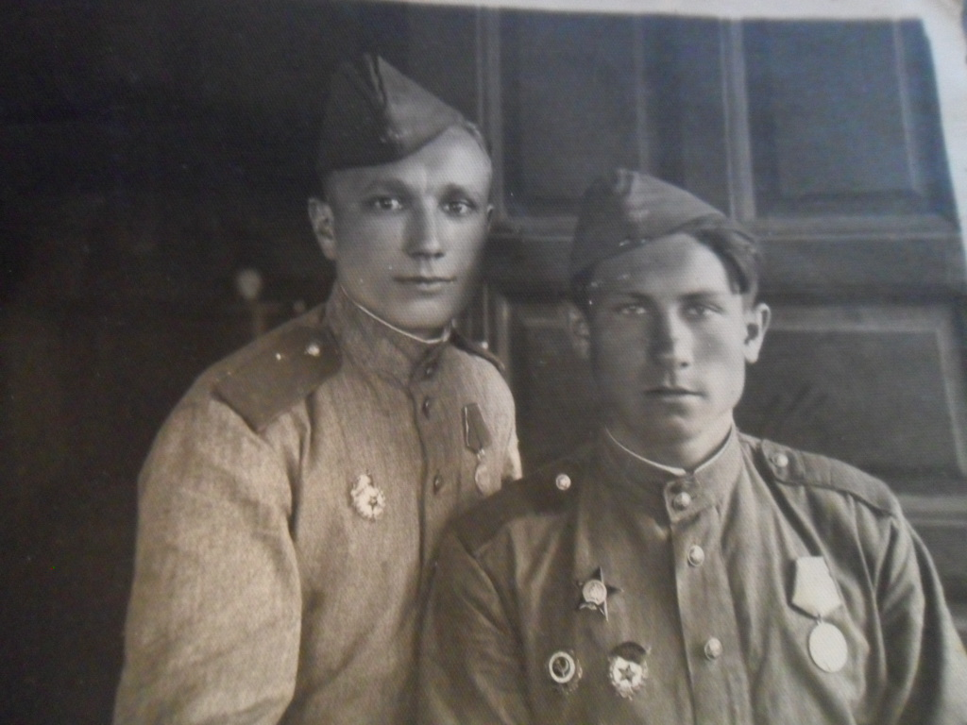
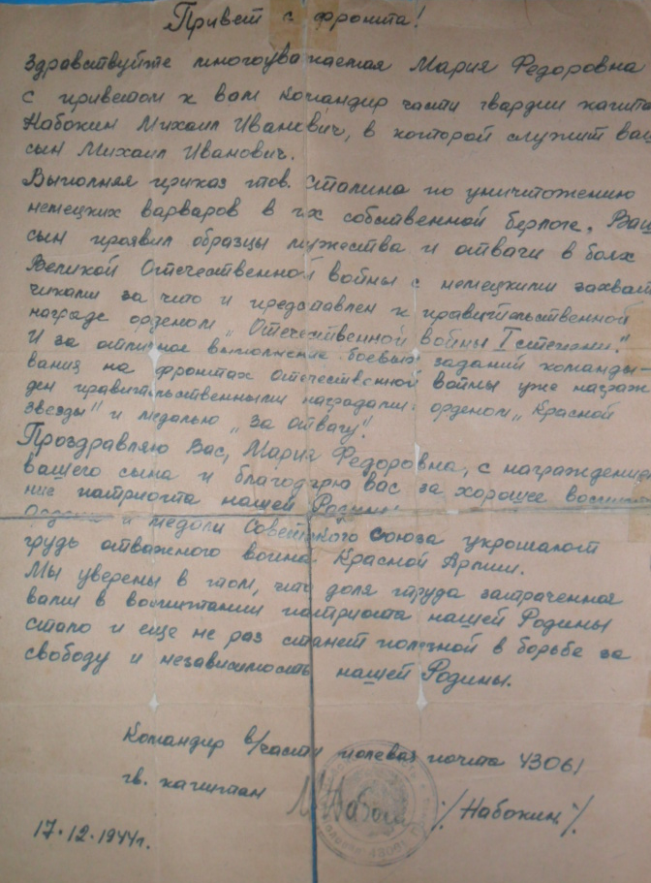
Mom grandfather Misha received a letter of thanks for bringing up his son from the unit commander.

Slide 4
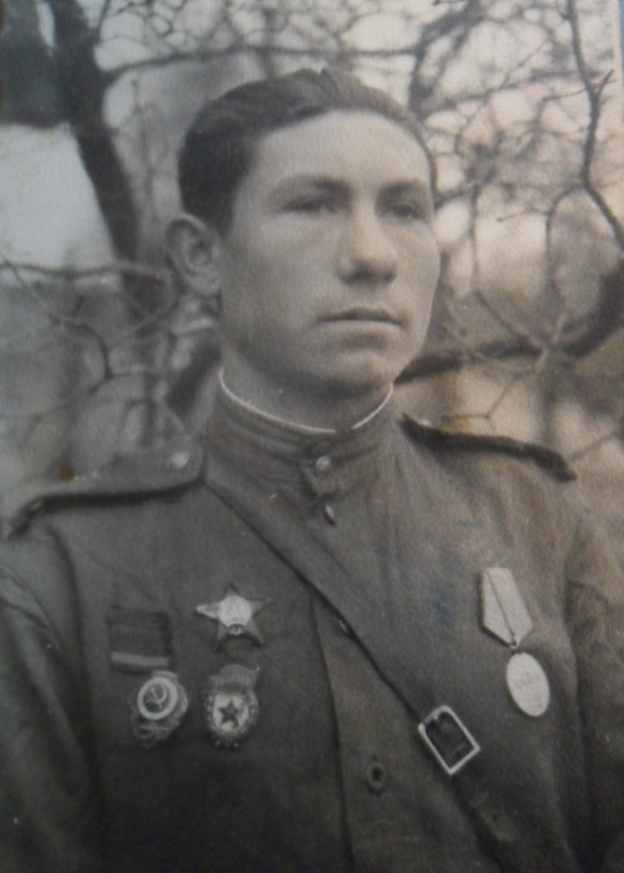
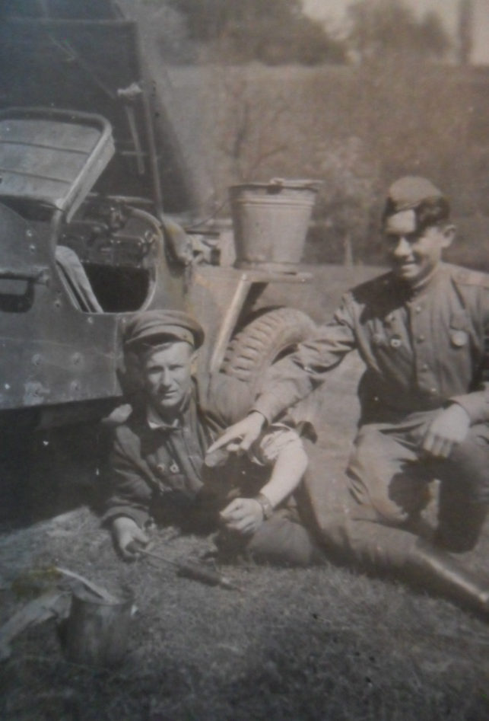
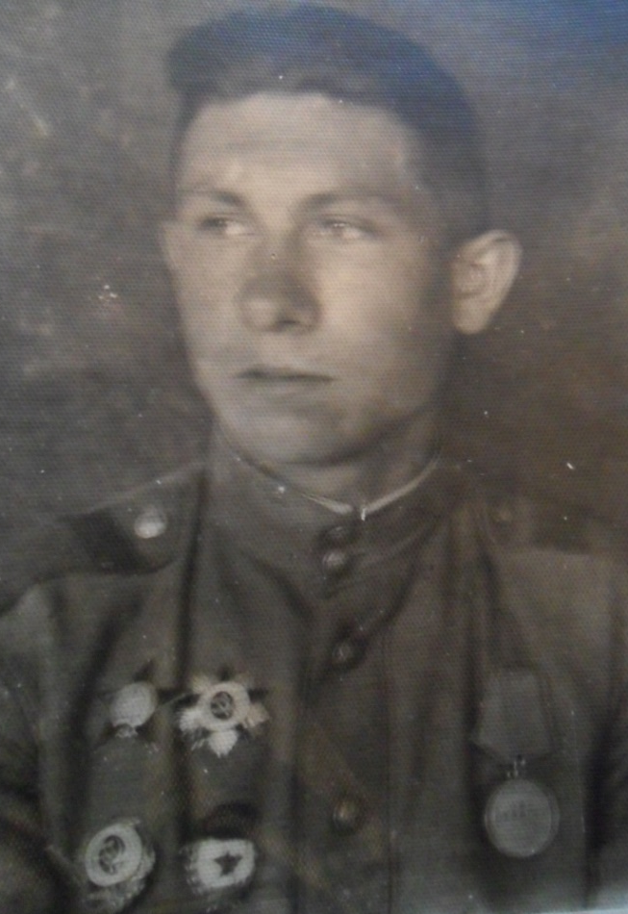
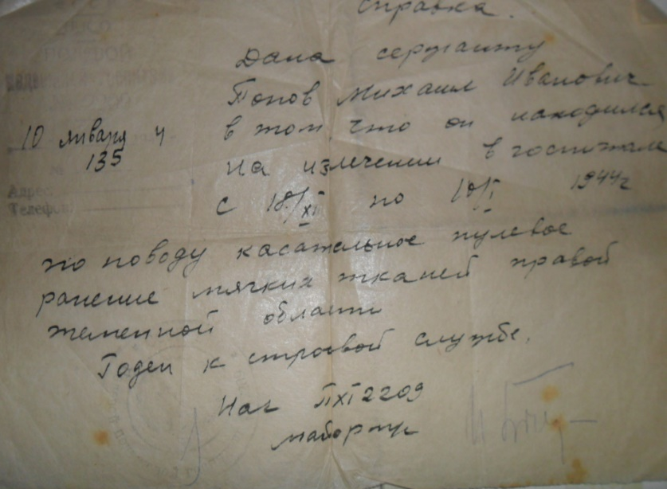
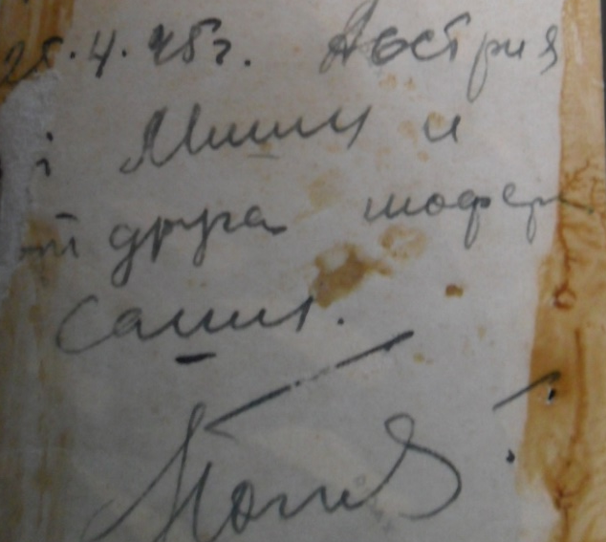
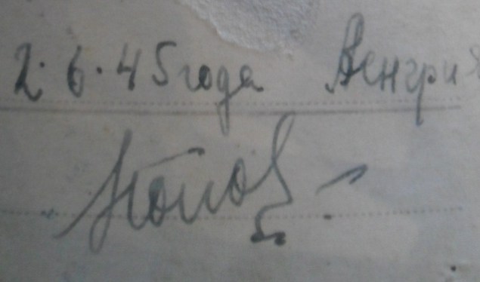
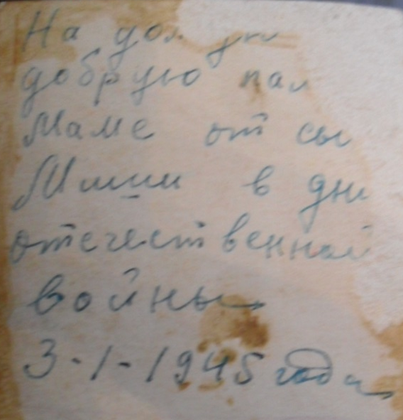
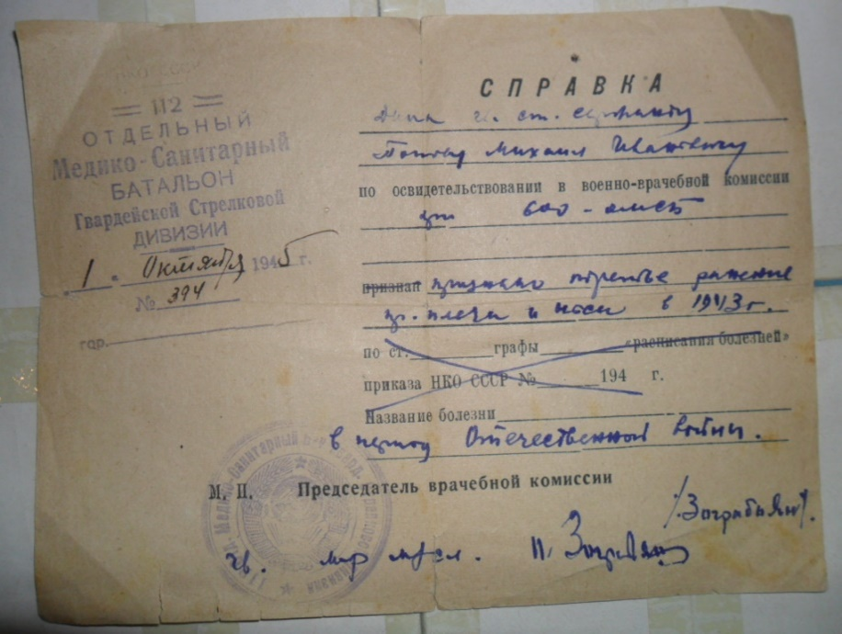
In the battles with the Nazis grandfather was wounded four times, and many of his friends and comrades were killed.

Slide 5
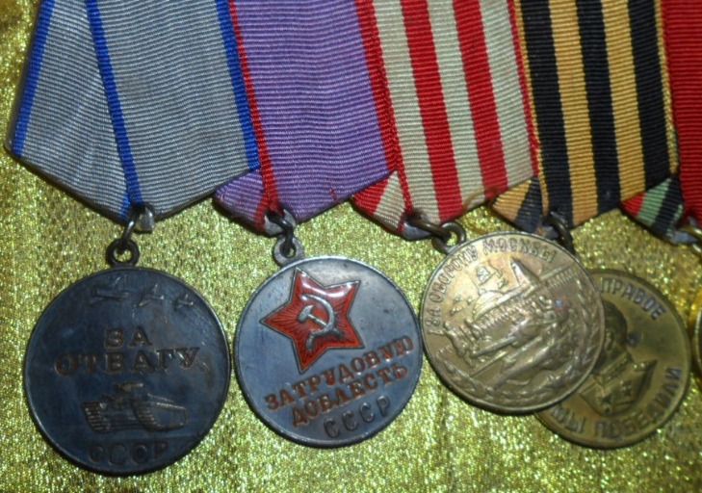
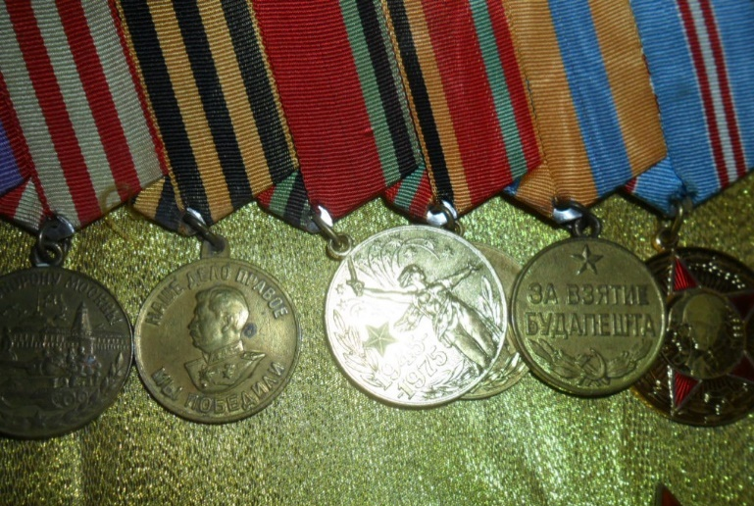
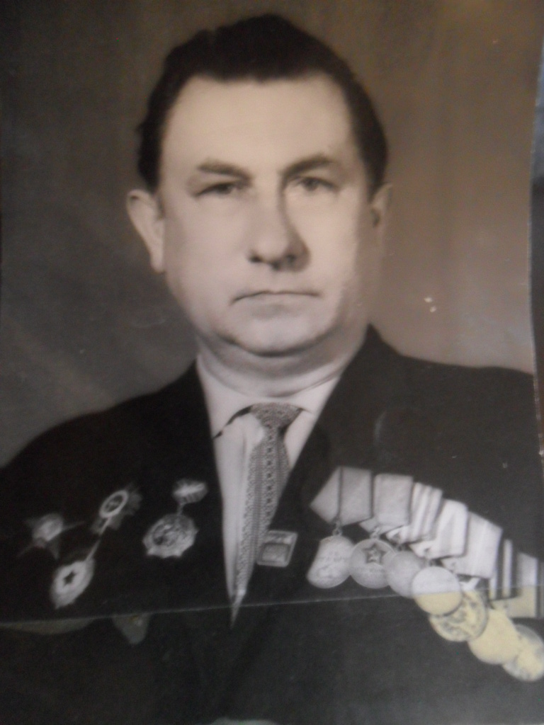
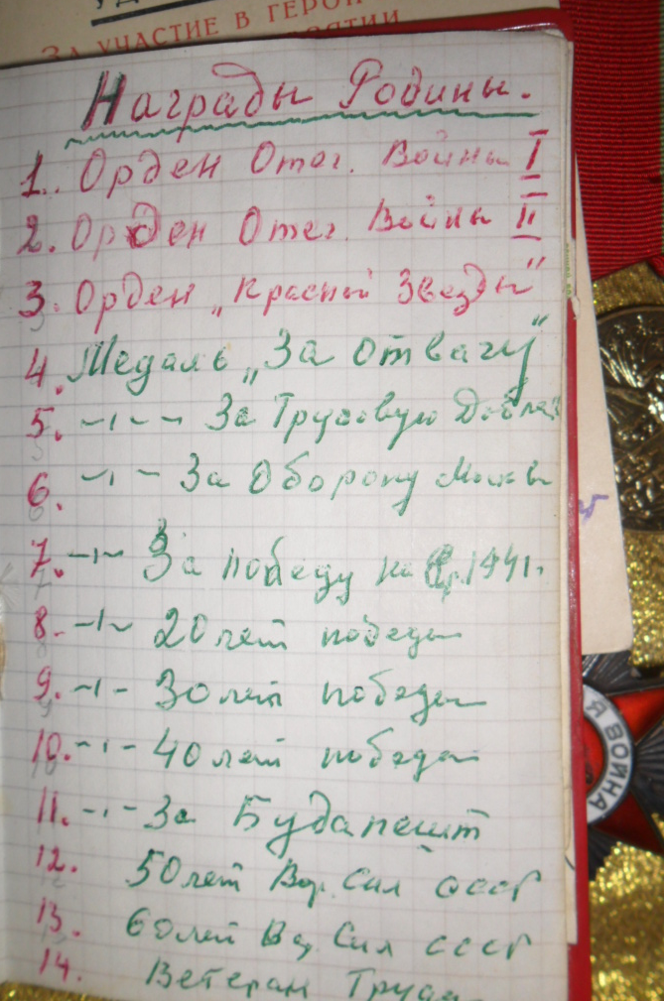
After World War II Mikhail Popov had worked in Flight Research Institute of Gromov, in his native town of Zhukovsky. And next to military awards scout on his chest grandfather medals for the peaceful labor.

Slide 6
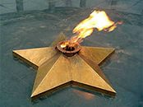
THE END!

