Slide 1
Эти забавные животные
Проектную работу выполнила ученица 2Г класса
МБОУ Гимназия
имени А.И. Яковлева

Slide 2
Project «My pet» Plan
I have got a pet.
It is a …….
Its name is Pushok.
It is grey. Pushok is funny.
It can jump.
My pet likes milk, meat and fish.
I like Pushok.

Slide 3
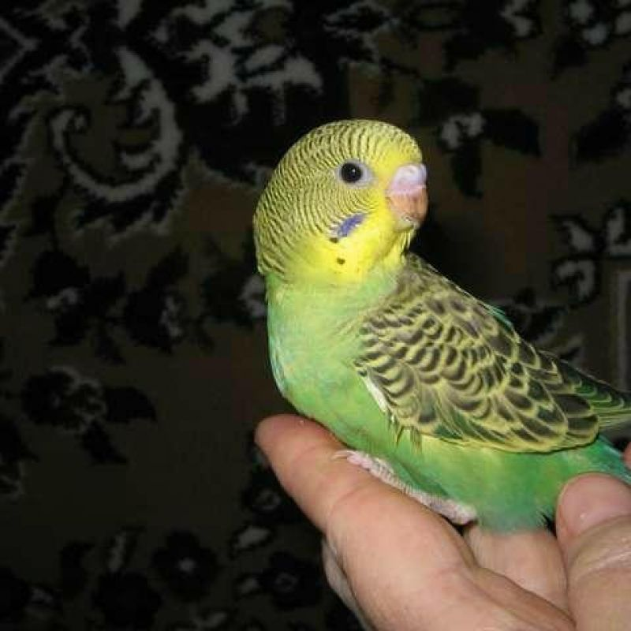
I’m from Russia. I’m nine. I like to help mum and dad about the house.
I love animals.
We have got a a cat
and a parrot.
I like to feed them.

Slide 4
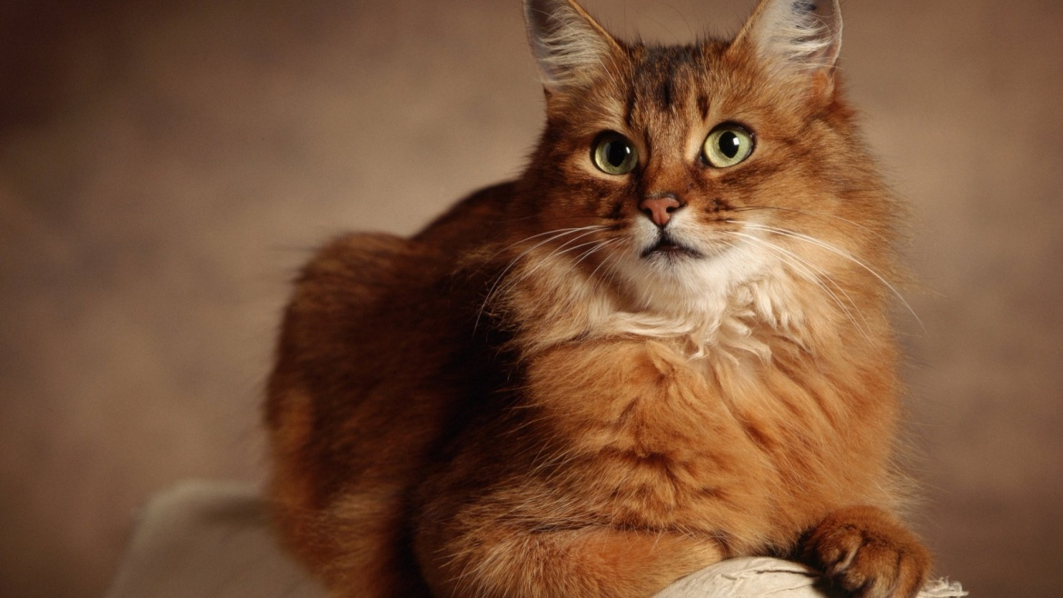
The cat’s name is Sonya. It is very funny and beautiful. Sonya has fluffy grey hair and yellow eyes. It likes to eat meat and fish. I give her milk every day.

Slide 5
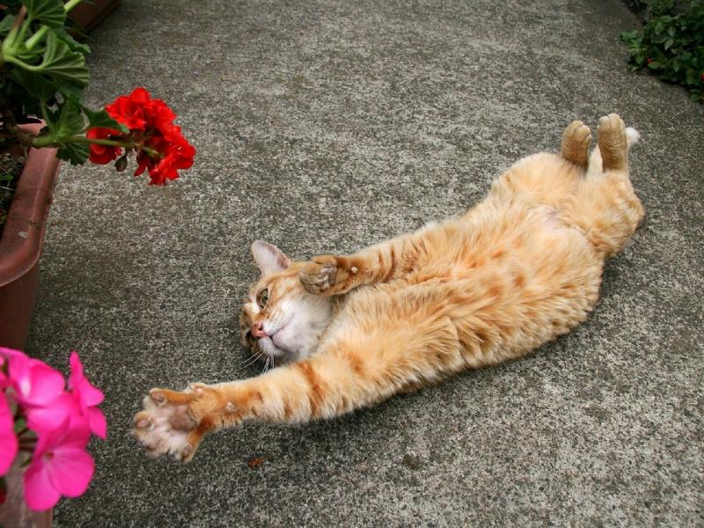
I play with Sonya every evening. My cat can sing songs . We run, jump and play ball.
I love my cat
very much!

Slide 6
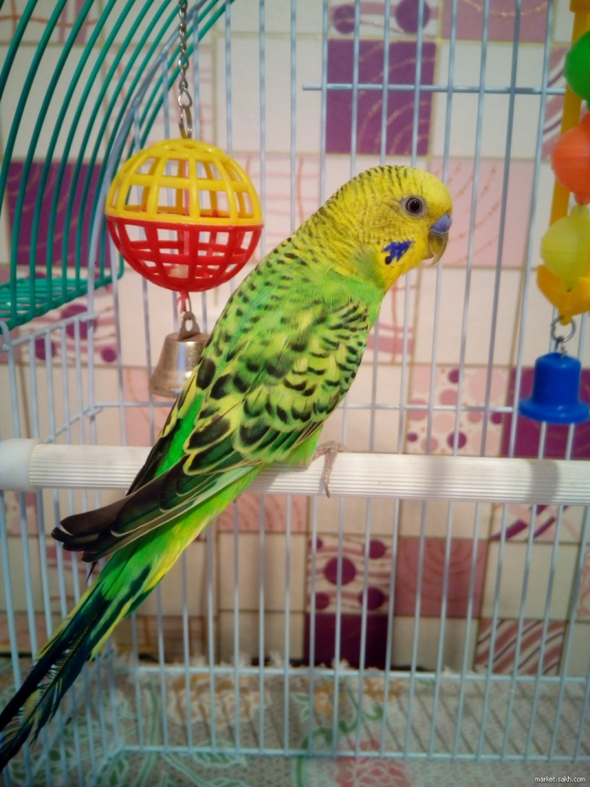
I have a parrot. His name is Kesha.
He likes to eat seeds and to fly.
My parrot speaks with me.

Slide 7
I love my pets.

